Slide 1
Anti-psychiatric Therapeutic Interchanges: A Narrative Reviews
Yousef Ahmed Alomi, Faiz Abdullah. Bahadig

Slide 2
ABSTRACT:
Objective: To review the anti-psychiatric therapeutic interchanges drug therapy. Methods: It is an extensive search, or fifty databases comprised the following through the Saudi Digital Library (SDL) searching engine. It included the various types of studies (meta-analysis, randomized controlled studies and observational studies) in the English language with human study only for the update May 2017. The search in terms of therapeutic interchange, medication, therapy and type of disease or medication base on therapeutics class of anti-psychiatric. The medication list and switch from one drug to alternative based on the literature found the search that has included comparative safety, efficacy and cost of the type of medication for each disease and national or international evidence-based guidelines.

Slide 3
ABSTRACT:
Results: The total number of studies after an extensive search with a specific term search was 487 studies. Of those, there were 107 repeated studies, and 380 studies included for future assessment. After assessment, there were 20 studies discussed the therapeutic interchange of anti-Psychiatry. Of those 20 studies, three studies included for evaluation. Conclusion: Anti-psychiatric therapeutic interchange is seldom finding in the kinds of literature. Few observational studies discussed this matter. Further studies claim to standardized Anti-psychiatric therapeutic interchange in practice.

Slide 4
Key Words :
Anti-psychiatric,
Therapeutic Interchanges,
Drug Therapy,
Literature,
Review.

Slide 5
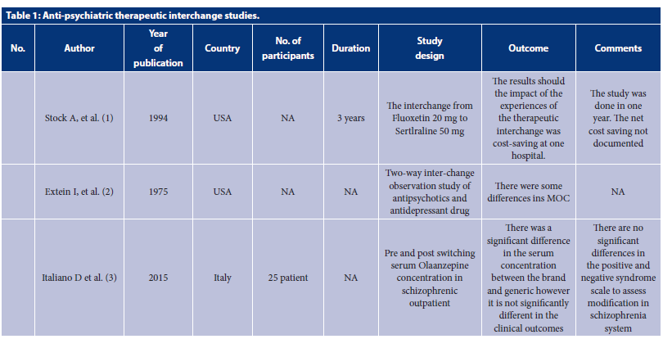

Slide 6
CONCLUSION:
Therapeutic interchange services are highly needed by all medical and surgical services, including psychiatric services. Few studies conducted for therapeutic interchange in psychiatric. However, comparative studies used all alternative methods for interchange therapy. The method was used in international and local therapeutic management guidelines. Further studies are highly demanded to validate psychiatric therapeutic interchange to prevent drug misadventures, drug-related problems and shortage stock of antipsychotic medications. The healthcare institutions appropriately use the suggested list to implement antipsychotic therapeutic interchange at healthcare organizations in the Kingdom of Saudi Arabia.

