Slide 1
Knowledge of Pharmacists about Nuclear Pharmacy Services in Saudi Arabia
Yousef Ahmed Alomi, Ali Taer Al-Asmri, Mohammed Abdulaziz Ayoub Asiri, Abdulaziz Saleh Alnabbah,

Slide 2
ABSTRACT:
Goal: The knowledge of nuclear pharmacy is essential in pharmacy practice. In addition, the nuclear pharmacy services demand various diagnoses and drug therapy management. In this study, we aimed to explore pharmacists’ knowledge about nuclear pharmacy in the Kingdom of Saudi Arabia. Methods: This is a cross-sectional qualitative study. In this study, we distributed an electronic validated reliability questionnaire to all pharmacists and pharmacy interns. Students were excluded from this study. The survey collected demographic data of the responders and the knowledge of pharmacists about nuclear pharmacy, radioactive drugs, and resources of nuclear pharmacy. Data were analyzed using Statistical Package of Social Science (SPSS), Microsoft Excel, and Survey Monkey system.

Slide 3
ABSTRACT:
Results: A total of 235 pharmacists responded to the survey questionnaire. Of them, 142 (63.96%) were male, and 80 (36.04%) were female, with a statistically significant difference between them (p<0.001). About two-thirds of the pharmacists had earned a Bachelor’s degree (149 (63.40%)) and Diploma in Pharmacy (75 (31.91%)), with statistically significant differences among all qualifications (p<0.001). The average score for pharmacists’ knowledge of nuclear pharmacy services was 1.61, with high scores obtained for the elements—knowledge of the nuclear pharmacist has additional salary in Saudi Arabia (1.76) and radiation safety considerations (1.73). The average score was obtained for knowledge of radiopharmaceutical products (1.63), and the highest score on knowledge was obtained for 131I-Sodium Iodide capsule five mCi (for thyroid therapy) (1.8) and 201Tl-Thallium solution five mCi (for cardiac imaging) (1.8). The resources used to access information about nuclear pharmacy services were drug information resources (93 (40.09%)), scientific literature (83 (35.78%)), and the internet (83 (34.48%)). Conclusion: The pharmacist’s knowledge of nuclear pharmacy services and radiopharmaceutical products was poor. Therefore, to expand nuclear medicine, including pharmacy-related nuclear services, we recommend implementing the education and training program on nuclear pharmacy in Saudi Arabia.

Slide 4
Key Words :
Knowledge,
Pharmacist,
Nuclear,
Pharmacy,
Saudi Arabia.

Slide 5
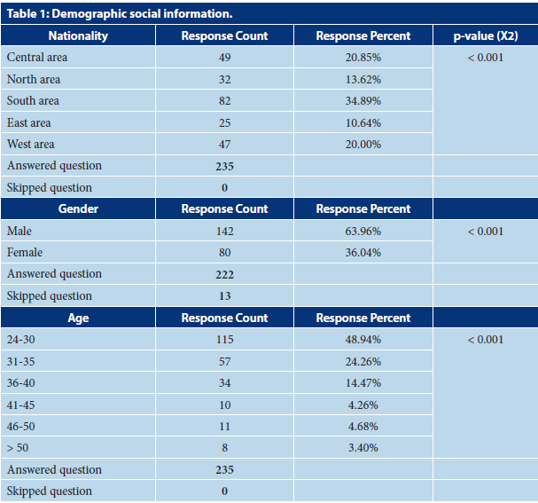

Slide 6
CONCLUSION:
In conclusion, pharmacists’ knowledge about nuclear pharmacy services and radioactive medications is deficient in the Kingdom of Saudi Arabia. Furthermore, the knowledge of pharmacists is varied, which is due to various factors. For example, pharmacists of a particular location or young people had less knowledge of nuclear pharmacy. However, there is no correlation between specific characteristics, for instance, location, age, gender, positions, and experiences. Therefore, we recommend further studies with large sample size and nuclear pharmacy-related issues in Saudi Arabia.

