Slide 1
Pharmacist’s Perception of Forensic Pharmacy Services
Yousef Ahmed Alomi, Samiyah Ibrahim Qassadi, Mawadah Mohsen Aqeeli, Rehab Sultan Najmi

Slide 2
ABSTRACT:
Goal: To illuminate the pharmacist perception of forensic pharmacy in Saudi Arabia. Methods: It is cross-sectional of convenient sampling and planned number of the subject with power eighty. An electronic survey was dispersed to the pharmacist and pharmacy intern, excluding pharmacy students and other healthcare professionals. The survey entailed of demographic data, pharmacist’s perception of forensic pharmacy, and barriers preventing implementation of forensic pharmacy. Survey monkey, Microsoft Excel, and Statistical Package of Social Science (SPSS) were used in this study.

Slide 3
ABSTRACT:
Results: The total number of responding pharmacists was 402. Of those, 198 (49.75%) were male, while 200 (50.25%) were female, with statistical significance between them (p<0.001). Almost three-quarters of the pharmacists had bachelor’s degrees 303 (75.56%), with statistically momentous among all pharmaceutical degrees (p<0.001). The total average scores of pharmacist perception of forensic pharmacy services were (3.93). The high scores element was under-working in forensic pharmacy in the healthcare institutions (4.15). On the contrary, the lowest score medical staff feel like their mistakes are held against them when an event is stated (3.35). The total average scores of barriers prevent the implementation of forensic pharmacy services were (3.41) with high scores element was lack of periodic training of pharmacy staff about forensic pharmacy (4.13). At the same time, the lowest score aspect of forensic pharmacy was the pharmacist shred in forensic sciences is too trivial to work (1.88). The most suggestions for facilitating forensic pharmacy implementation were implementing an electronic forensic pharmacy 306 (77.86%) and raise the number of forensic pharmacist staff by 319 (81.17%). Conclusion: The pharmacist had a positive insight of forensic pharmacy. However, various barriers are requisite to eliminate to start the implementation of forensic pharmacy services. Therefore, education and training are indispensable elements for establishing forensic pharmacy services in the Kingdom of Saudi Arabia.

Slide 4
Key Words :
Perception,
Pharmacist,
Forensic,
Pharmacy,
Saudi Arabia.

Slide 5
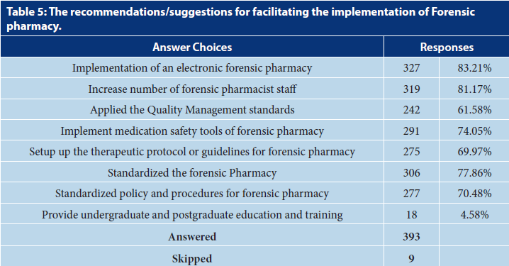

Slide 6
CONCLUSION:
The pharmacist’s perception of forensic pharmacy was optimistic. Various barriers prevent the forensic pharmacy implementation, for case, under pharmacy staff, undergraduate during the pharmacy school, postgraduate education and training, vision, mission, and absence of strategic forensic pharmacy plan. No factors disturb the responder’s answers except the gender emphasizing female, and career positions affected positively. Removing the barriers will simplify the implementation of a forensic pharmacy foundation in Saudi Arabia.

