Slide 1
Pharmacist’s Knowledge of Forensic Pharmacy Services
Yousef Ahmed Alomi,
Rehab Sultan Najmi, Mawadah Mohsen Aqeeli, Samiyah Ibrahim Qassadi,

Slide 2
ABSTRACT:
Goal: The knowledge of forensic pharmacy is a grave issue in practice. For example, forensic pharmacy services are obligatory for crime and drug-related death investigations. The current study purposes to affirm Pharmacist knowledge of forensic pharmacy in the Kingdom of Saudi Arabia. Methods: It was a qualitative examination with a cross-section design. An electronic validated and reliability survey was dispersed to all pharmacists and pharmacy interns. All students were omitted from the study. The questionnaire checked demographic data about the responders and pharmacist’s basic and advanced knowledge of forensic pharmacy and resources of forensic pharmacy. Statistical Package of Social Science (SPSS), Microsoft Excel, and survey monkey did all analysis.

Slide 3
ABSTRACT:
Results: The total number of responding pharmacists was 402. Of those, 198 (49.75%) were male, while 200 (50.25%) were female, with statistical significance between them (p<0.001). Almost three-quarters of the pharmacists had bachelor’s degrees 303 (75.56%), with statistically significant among all pharmaceutical degrees (p<0.001). The total average scores of pharmacists’ knowledge of forensic pharmacy services were (2.0) with high scores element was the valuation of basic knowledge of the forensic pharmacy was the medications induced addiction (2.74). In contrast, the lowest scores were the job description of forensic pharmacist (1.5). The average score advances knowledge of forensic pharmacy (1.92). The highest score knowledge was the cardiovascular medications (3.00), while the lowest score knowledge of advanced knowledge of forensic pharmacy was the resources of forensic pharmacy (1.37). The most resources applied for Forensic pharmacy services were internet 224 (56.71%) and healthcare practitioners 222 (56.20%). Conclusion: The pharmacists’ knowledge of forensic pharmacy services was insufficient. Therefore, the preventing of crimes problems and drug-related death are obligatory to improve patient outcomes. The undergraduate and postgraduate education and training of forensic pharmacy services in highly recommended in Saudi Arabia.

Slide 4
Key Words :
Knowledge,
Pharmacist,
Forensic,
Pharmacy,
Saudi Arabia.

Slide 5
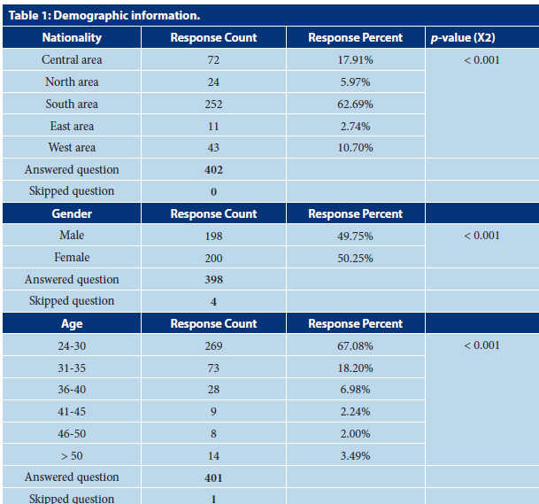

Slide 6
CONCLUSION:
The current electronic survey with the convenient method and tolerable sample size discussed the pharmacist’s knowledge of forensic pharmacy services that was poor. Pharmacists know medication-induced addition or narcotics law, while forensic pharmacist job description with unsatisfactory knowledge. The primary and advanced forensic pharmacy knowledge is exaggerated by the number of year’s experiences and career positions. The implementation of education and training of forensic pharmacy is mandatory to improve new services in Saudi Arabia.

