Slide 1
Knowledge of Pharmacists about Pharmacy Infection Control in Saudi Arabia
Yousef Ahmed Alomi, Ghudair Tashan Alanazi,
Amani Abdullah Bahdailah, Hussa Mubarak Muwainea,
Razan Alshehri

Slide 2
ABSTRACT:
Objective: In this study, we aimed to assess pharmacists’ knowledge about pharmacy infection control in the Kingdom of Saudi Arabia. Methods: This crosssectional survey study was conducted to assess pharmacists’ knowledge about pharmacy infection control in Saudi Arabia. We used a self-reported electronic survey questionnaire and distributed it to pharmacists, including dentists from interns to consultants and pharmacy specialists in Saudi Arabia. The survey collected demographic information of the responders and their knowledge regarding some of the selected pharmacy infection control elements in dental care. We also collected information regarding the resources they use to obtain knowledge of pharmacy infection control. We used 5-point Likert response scale system with close-ended questions to obtain their responses. The data were collected through the Survey Monkey system and analyzed using Statistical Package of Social Sciences (SPSS), Jeffery’s Amazing Statistics Program (JASP), and Microsoft Excel (version 16) software.

Slide 3
ABSTRACT:
Results: A total of 435 pharmacists responded to the questionnaire, with one-quarter of them coming from the central region (97 (22.35%)), and northern region (92 (21.2%)), with non-statistically significant differences between regions (p=0.637). Of the total responders, 212 (48.96%) were female, and 221 (51.04%) were male responders, with non-statistically significant differences between them (p=0.665). Most of the responders were in the age group of 24–30 years (151 (34.87%)) and 36–40 years (101 (23.33%)), with statistically significant differences between them (p=0.000). The total average score of pharmacy infection control assessment for basic knowledge was 3.34, with high scores obtained for the elements knowledge of hand hygiene (3.86) and personal protective equipment (3.83). In comparison, the lowest scores were obtained for the elements knowledge of the accidental sharp devices immunization system (2.80), and the infection control pharmacist gets more salary than regular pharmacist (2.91). The total average score of knowledge of frequently used disinfection and antiseptics products at your healthcare institution (3.60) and the high scores were obtained for the elements knowledge of peroxygens (hydrogen peroxide) (4.63) and alcohol (isopropyl alcohol 70%) (4.63). In comparison, the lowest scores were obtained for the element knowledge of phenolics (ortho-benzyl-parachlorophenol) (2.76) and the iodophors (povidone-iodine ointment 10%) (2.99). The score for the single-test reliability analysis of McDonald’s ω was 0.927, Cronbach’s αwas 0.924, Gutmann’s λ2 was 0.933, Gutmann’s λ6 was 0.973, and Greater Lower Bound was 0.989.

Slide 4
Conclusion: Pharmacists’ knowledge about pharmacy infection control was inadequate in the Kingdom of Saudi Arabia. Therefore, targeting to provide the necessary education and training for undergraduate and postgraduate students to improve patient infection control within pharmaceutical care in Saudi Arabia.

Slide 5
Key Words :
Knowledge,
Pharmacist,
Pharmacy,
Infection Control,
Saudi Arabia.

Slide 6
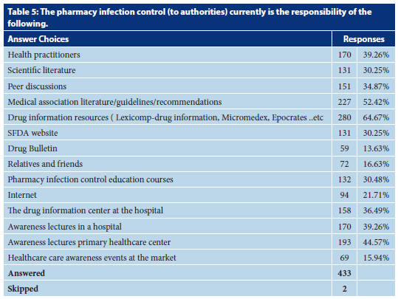

Slide 7
CONCLUSION:
In summary, the knowledge of pharmacists about pharmacy infection control was found to be insufficient. The results were affected by various factors, such as young age, less work experience, lower position held, had inadequate knowledge. Therefore, education and training should be provided during the residency program to increase their knowledge about infection control. Consequently, we recommend that pharmacy infection control be founded at all healthcare organizations in Saudi Arabia.

