Slide 1
Research Policy on Case-control and Cohort Study Design in Pharmaceutical Care
Yousef Ahmed Alomi, Amal Hassan Al-Najjar,
Maha Hussein Almadany, Fakhar Al-Ayoubi,
Ghudair Tashan Alanazi, Abeer Hussin Almasoudi

Slide 2
ABSTRACT:
Objectives: This study explores the Research Policy of Case-Control and Cohort Study Design in Pharmacy Practice as a new initiative in Saudi Arabia. Methods: This article is a narrative review of pharmacy research. Litterateur researched specific research policies and procedures in pharmacy practice using a variety of databases, including PubMed, Medline, and Google Scholar. The period covered for the search is from the 1960s to October 2021. The terms used are in the English language and encompasses narrative reviews, systemic reviews, meta-analyses, and guidelines. The search term includes all hospital and community pharmacy-related services. Besides, there are national and international guidelines for conducting general research in hospital practice. The pharmacy research committee was formed and comprised numerous expert members, including clinical pharmacists, pharmacists specializing in drug information, and clinical research specialists. A member drafted the policy’s guidelines, which were then reviewed and corrected by another member. The research specialist made the third revision. The subject emphasizes the Pharmacy Research Policy for the Case-Control and Cohort Study Model.

Slide 3
ABSTRACT:
Results: The Pharmacy Research policy for the Case-Control and Cohort Study Design in pharmaceutical care services consisted of several components, including the advantages and disadvantages of Case-Control and Cohort Study Design and the steps involved in conducting Case-Control research, and the steps involved in conducting Cohort Study research in pharmacy practice. Conclusion: The pharmacy research policy for the Case-Control and Cohort Study Design is a new initiative as part of the pharmaceutical care services. The pharmacy policy on Case-Control and Cohort Studies aims to improve pharmacists’ research abilities in healthcare institutions. Additionally, the new tools for documenting and validating adverse drug reactions. Therefore, the Case-Control and Cohort Study research policies in pharmacy are recommended for implementation in Saudi Arabia.

Slide 4
Key Words :
Research,
Policy,
Pharmacy,
Case-Control,
Cohort Study,
Saudi Arabia.

Slide 5
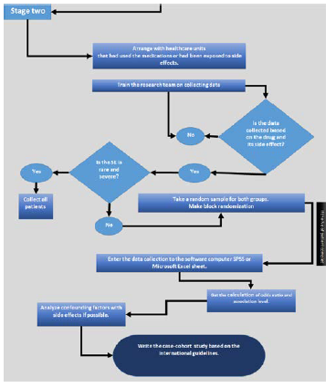

Slide 6
CONCLUSION:
Case report and cohort study design policies and procedures are beneficial for monitoring both short- and long-term drug therapy. It encourages pharmacists to document medication management complications and raises pharmacists’ awareness of the voidability of drug morbidity and mortality. The current study’s policies and procedures address critical issues in pharmacy practice and are highly recommended for implementation in pharmaceutical care services.

