Slide 1
The Practice of home healthcare services by Pharmacists in Saudi Arabia
Yousef Ahmed Alomi, Maha Hussein Almadany, Areej Abdullah Al Jasser, Fawaz Abdullah Alrakaf, Fatima Abdulqader Alshamrani, Hussa Mubarak Muwainea, Osama Ali Alzahrani

Slide 2
ABSTRACT:
Objectives: To illustrate the practice of home healthcare services by pharmacists in Saudi Arabia. Methods: It analyzes a cross-sectional survey that discussed practice at home health care services in Saudi Arabia. The study comprised respondents’ demographic information about pharmacists and home healthcare pharmacy services implementation and resources used for home healthcare pharmacy services. The 5-point Likert response scale system was used with closed-ended questions. The survey was validated through the revision of expert reviewers and pilot testing. Besides, various tests of reliability, McDonald’s ω, Cronbach alpha, Gutmann’s λ2, and Gutmann’s λ6, were done with the study. Furthermore, the data analysis of the practice home healthcare services by pharmacists in Saudi Arabia is done through the survey monkey system. Besides, the statistical package of social sciences (SPSS), Jeffery’s Amazing Statistics Program (JASP), and Microsoft Excel sheet version 16.

Slide 3
ABSTRACT:
Results: A total number of 393 pharmacists responded to the questionnaire. Of them, more than three-quarters responded from the Central region (303 (77.10%)), with statistically significant differences between the provinces (p=0.000). Males responded less than females (195 (49.74%)) versus 197 (50.26%%)), with statistically non-significant differences between them (p=0.920). Most of the responders were in the age group of 24-35 years (267 (67.94%)) and 36-45 years (121 (30.79%)), with statistically significant differences between all age groups (p=0.000). The average number of home healthcare prescriptions was (17.46) daily per responder, with a total number (6,861) per day. The highest range number of prescriptions was (26-30) ((33.93%) daily. Those prescriptions were dispensed to home healthcare (8.34) patients daily per each responder, with the highest range number of patients being (16-18) ((25.95%) daily per each responder. The average score of the practice of pharmacists about the home healthcare Pharmacy implementations was (4.45). The element “The medication error system is included in home healthcare pharmacy services” obtained the highest score (4.60). The pharmacists believe that “The research on home healthcare pharmacy services” (4.57) and “The cost analysis of home healthcare pharmacy services. The most used resources of the home healthcare pharmacy services in practice were Health Practitioners 265 (67.60%) and Drug Bulletin 246 (62.76%). They were followed by Internet 241 (61.48%), Scientific literature 212 (54.08%).

Slide 4
ABSTRACT:
Conclusion: The home care pharmacy practice by pharmacists is appropriate. Each pharmacist provides home care activities based on each type of healthcare organization. The vision, mission, and home care pharmacy strategy should be identified, and the home care pharmacist role must be unified at all healthcare institutions. Besides, further research about home care pharmacy practice is highly suggested in Saudi Arabia.

Slide 5
Key Words :
Practice,
home,
healthcare services,
Pharmacists,
Saudi Arabia.

Slide 6
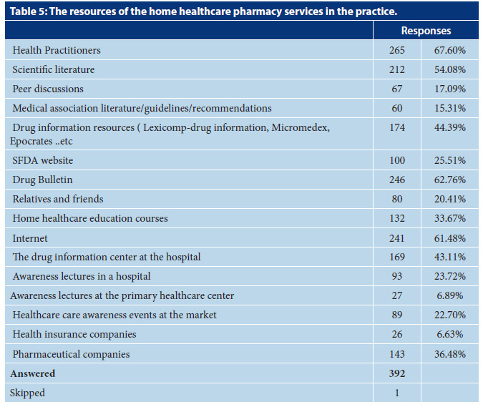

Slide 7
CONCLUSION:
The home care pharmacy practice was appropriate. Most pharmacists showed medication error prevention and documentation, research in-home care pharmacy, and cost analysis of home care pharmacy services as the highest components in practice. In contrast, the home care pharmacy’s vision, mission, and annual plan were the lowest practice elements. Most pharmacists refer to health care practitioners, drug bulletins, and internet platforms as home care pharmacy services resources. Various factors might negatively affect or positively affect the home care pharmacy practice, such as location, working sites, experience, and pharmacist position. Besides, the number of home care patients and related prescriptions. The home care pharmacy should be universal with standardized pharmacy and associated regulations in Saudi Arabia.

