Slide 1
Knowledge of Pharmacists about Health Insurance in Saudi Arabia
Yousef Ahmed Alomi, Abdulaziz Saad Ali Alrobiea,
Shaimaa O Ahmadeen, Mohammad Abdullah Alghamdi,
Maha Hussein Almadany, Abeer Hussin Almasoudi,
Atheer Fahad Al-Aqile

Slide 2
ABSTRACT:
Objectives: To explore the knowledge of pharmacists about health insurance in Saudi Arabia. Materials and Methods: It analyzes a cross-sectional survey that discussed Pharmacist knowledge of health insurance in Saudi Arabia. The survey consisted of respondents’ demographic information about pharmacists, The health insurance assessment of primary and advanced knowledge, and The Resources used about the health insurance drug therapy. The 5-point Likert response scale system was used with closed-ended questions. The survey was validated through the revision of expert reviewers and pilot testing. Besides, various tests of the reliability of McDonald’s ω, Cronbach alpha, Gutmann’s λ2, and Gutmann’s λ6 were done with the study. Furthermore, the data analysis of the Knowledge of Pharmacists about Health Insurance is done through the survey monkey system. Besides, the statistical package of social sciences (SPSS), Jeffery’s Amazing Statistics Program (JASP), and Microsoft Excel sheet version 16.

Slide 3
ABSTRACT:
Results: A total number of 398 pharmacists responded to the questionnaire. Of them, more than one-third responded from the Central region (137 (34.51%)), and one Quarter responded from the western part (109 (27.46%)), with statistically significant differences between the provinces (p=0.000). Males responded more than females (239 (60.35%)) versus 157 (39.65%)), with statistically significant differences between all levels (p=0.000). Most of the responders were in the age group of 24-30 years (271 (68.26%)) and 31-35 years (56 (14.11%)), with statistically significant differences between all age groups (p=0.000). Most of the pharmacists were staff pharmacists (300 (75.76%)) and pharmacy supervisors (43 (10.86%)), with statistically significant differences between all levels (p=0.000). Almost one-half of pharmacists currently have health insurance coverage (239 ((60.05%)) with equal or less than one year (108 ((42.52%)), or 2-3 years (81 ((31.89%)), have you been associated with your current insurance provider with statistically significant differences between all levels (p=0.000). The average score of basic knowledge of pharmacists about health insurance was (1.91). The element “the ethics used in health insurance pharmacist” obtained the highest score (2.19). The aspect “the health insurance system covered the medications errors sentinel event” (2.05). The average score of advanced knowledge of pharmacists about health insurance was (1.95). The element “the knowledge of medications covered by health insurance” obtained the highest score (2.38). The aspect “the knowledge of the medications devices and health insurance” was (2.17). The most resources used for Pharmacist and health insurance information were health practitioners 179 (46.25%) SFDA website 128 (33.07%). They were followed by Scientific literature 117 (30.23%) and Drug information resources ( Lexi comp-drug information, Micromedex, Epocrates 101 (26.10%).

Slide 4
ABSTRACT:
Conclusion: The pharmacist’s knowledge of health insurance was insufficient in Saudi Arabia. The Heath insurance pharmacy is in high demand for transformation plans with vision. Therefore, Targeting education and training during undergraduate and postgraduate studies is highly recommended in Saudi Arabia.

Slide 5
Key Words :
Knowledge,
Pharmacists,
Health,
Insurance,
Saudi Arabia.

Slide 6
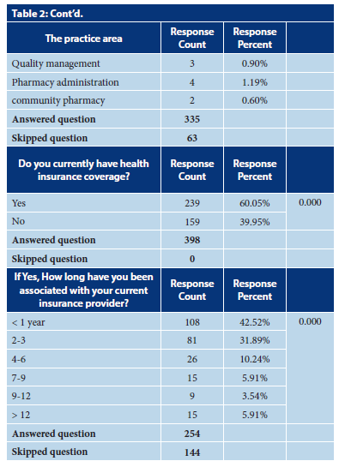

Slide 7
CONCLUSION:
The knowledge of pharmacists about Heath insurance system was insufficient. Most pharmacists were familiar with sentinel drug-related problems and medications with their devices covered by Heath insurance regulations. In contrast, the pharmacist is unfamiliar with the pharmacist’s role in Heath insurance services or related job descriptions and international guidelines of Heath insurance pharmacists. Besides, therapeutics guidelines, unapproved indications, and some medications such as oncology drugs, herbal medicines, and pharmacy health insurance. Various factors might affect pharmacist knowledge about Heath insurance services, such as work sites and Heath insurance coverage. Targeting revision and standardization of pharmacy Heath insurance services are highly recommended. Besides, undergraduate and undergraduate education and training in Heath insurance in pharmacy practice are highly suggested in Saudi Arabia

