Slide 1
Practice of Cardiopulmonary Resuscitation Services by Pharmacists in Saudi Arabia
Yousef Ahmed Alomi, Samah Mukhlef Alzaid, Wafa Hussain Alshehre, Rola AL Kenani, Khawlah Ibrahim Alshahrani

Slide 2
ABSTRACT:
Objectives: To explore the pharmacist practice of CPR services in Saudi Arabia. Methods: The study analyzed a cross-sectional survey that discussed the Pharmacist practice of Cardiopulmonary Resuscitation (CPR) in Saudi Arabia. The survey consisted of respondents’ demographic information about pharmacists, The availabilities of CPR teams, and pharmacist participation in the teams. The hospital’s specialties had pharmacy personnel participate with the CPR code. Besides activities the pharmacist provides during CPR code, medications are mainly used for CPR code and pharmacy CPR services implementations. The 5-point Likert response scale system was used with closed-ended questions. The survey was validated through the revision of expert reviewers and pilot testing. Besides, various tests of the reliability of McDonald’s ω, Cronbach alpha, Gutmann’s λ2, and Gutmann’s λ6 were carried out with the study. The data analysis of the Pharmacist practice of Cardiopulmonary Resuscitation (CPR) medications is done through the survey monkey system. Besides, the statistical package of social sciences (SPSS), Jeffery’s Amazing Statistics Program (JASP), and Microsoft Excel sheet version 16 were implemented.

Slide 3
ABSTRACT:
Results: A total number of 439 pharmacists responded to the questionnaire. Of them, more than one-third responded from the Central region (122 (31.69%)), one Quarter responded from the Eastern part (91 (23.64%)), and one-fifth responded from the southern region (79 (20.52%)). Males responded more than females (203 (53.14%)) versus 179 (46.86%)), with statistically non-significant differences between all levels (p=0.219). Most of the responders were in the age group of 36-45 years (152 (39.48%)) and 46-55 years (134 (34.81%)), with statistically significant differences between all age groups (p=0.000). The majority of pharmacists had training courses in Basic Life Support (BLS) (293 ((77.11%)), Advance Cardiac Life Support (ACLS) (289 ((76.05%)), Pediatric Cardiac Life Support (PCLS) (287((75.53%)), and Neonatal Cardiac Life Support (NCLS) (203 ((53.42%)), with statistically significant differences between all levels (p=0.000). Most pharmacists participated with CPR code with Adults CPR team 317 (81.07%), Neonates CPR team 236 (59.75%), and Pediatric CPR team 230 (58.08%). Most hospital specialties had pharmacy personnel and participated with CPR code: Emergency 339 (86.26%) and Medical (76.59%). The activities provided during the CPR code by pharmacists mostly were the Administration of medications 314 (71.69%), Preparation and dispensing of medications 278 (63.47%), and Providing drug information 267 (60.96%). During ACLS, the most used medicines were Amiodarone 326 (77.99%), Dobutamine 323 (74.94%), and Procainamide 304 (74.33%). The average score of implemented items for CPR services was (4.09). The “Mission of CPR” element obtained the highest score (4.23). The aspect “The vision of CPR including the (ACLS-PCLS-NCLS)” was (4.18). In contrast, the lowest score was obtained for the element “Policy and procedure of CPR” (3.94). The score for the component “The strategic plan of CPR” was (4.02), with a statistically significant difference between the responses (p<0.009).

Slide 4
ABSTRACT:
Conclusion: The pharmacist’s full practice in CPR services is insufficient at most healthcare organizations. Pharmacist participation in the CPR code with whole provides distributive and clinical services that are highly demanded to prevent drug misadventures and improve patient clinical outcomes in the kingdom of Saudi Arabia.

Slide 5
Key Words :
Practice,
Cardiopulmonary Resuscitation,
Services,
Pharmacists,
Saudi Arabia.

Slide 6
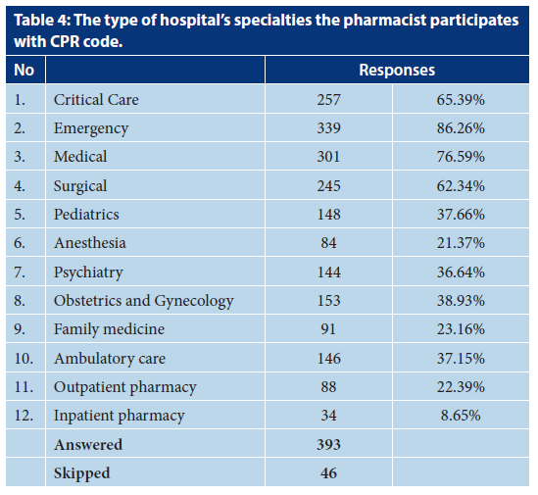

Slide 7
CONCLUSION:
One-half of the responders had CPR teams for adults, pediatrics, and neonatal patients. The majority of the pharmacists had participated in adult CPR services. But, they had a lesser extent of participation in pediatric and neonatal CPR services. The medical and surgical departments had fewer CPR services in the anesthesia section. Most pharmacists prepare and administer medication and drug information during the CPR code. The average pharmacist practice implementation of CPR services was appropriate and had a mission and vision of pharmacist CPR services and lesser found of Pharmacy CPR strategies planning. Various factors might affect the pharmacy CPR implementation, such as age, existing of CPR teams, and pharmacist participation in the CPR teams. Therefore, targeting to expand the pharmacy CPR services with much involvement of clinical pharmacy services is highly recommended in healthcare practice in Saudi Arabia.

