Slide 1
Perception of Pharmacists About the High-Risk/Alert Medications in Saudi Arabia
Yousef Ahmed Alomi, Mohammad Abdulaziz AL-Tuwaijri, Nouf Saad Al-Saban, Maha Hussein Almadany, Faisal Safouq Alanazi

Slide 2
ABSTRACT:
Objectives: To demonstrate the perception of pharmacists about the High-Risk/ Alert medications in Saudi Arabia. Methods: It analyzes a cross-sectional survey that discussed the perception of pharmacists about High-Risk/Alert medications in Saudi Arabia. The survey consisted of respondents’ demographic information about pharmacists and The Perception of High-Risk/Alert Medications, barriers, which factors may Discourage you from implementing High-Risk/Alert medications, and recommendations/suggestions for facilitating the implementation of High-Risk/Alert medicines. The 5-point Likert response scale system was used with closed-ended questions. The survey was validated through the revision of expert reviewers and pilot testing. Besides, various tests of reliability, McDonald’s ω, Cronbach alpha, Gutmann’s λ2, and Gutmann’s λ6, were done with the study. In addition, the data analysis of the Perception of Pharmacists About the High-Risk/Alert Medications in Saudi Arabia is done through the survey monkey system. Besides, the statistical package of social sciences (SPSS), Jeffery’s Amazing Statistics Program (JASP), and Microsoft Excel sheet version 16.

Slide 3
ABSTRACT:
Results: A total number of 442 pharmacists responded to the questionnaire. Of them, more than one-third responded from the Central region (183 (40.40%)), and one Quarter responded from the Western part (119 (26.92%)), with statistically significant differences between the provinces (p=0.000). Males responded more than females (264 (59.59%)) versus 179 (40.41%)), with statistically significant differences between all levels (p=0.000). Most of the responders were in the age group of 24-30 years (266 (59.91%)) and 31-35 years (78 (17.57%)), with statistically significant differences between all age groups (p=0.000). Most of the pharmacists were staff pharmacists (323 (72.75%)) and pharmacy supervisors (56 (12.61%)), with statistically significant differences between all levels (p=0.000). The average score of perception of pharmacists about High-Risk/Alert medications was (3.88). The element “Staff compliance with protocols, guidelines and order sets related to high-alert medications is required” obtained the highest score (4.38). The pharmacists believe that Standard protocols, order sets, and orders express IV and neuraxial high-alert medication infusions/doses are highly recommended (4.36). The average score for the element “Factors Discourage you to implement High-Risk/Alert medications” was (3.36). The highest score from the component “The High-Risk/Alert medications are of a serious nature” was (3.92). The score for the element “Lack of Periodic training of pharmacy staff about High-Risk/Alert medications ” was (3.83), and “Low level of clinical knowledge of High-Risk/Alert medications “was (3.70). The most recommendations/suggestions for facilitating the implementation of High-Risk/Alert medications were the Implementation of an electronic high-alert medications system 385(88.30%), setup up the therapeutic protocol or guidelines for High-Risk/Alert medications 347 (79.59%), and standardizing the prescribing, preparation, dispensing and administration of High-Risk/Alert drugs 345 (79.13%).

Slide 4
ABSTRACT:
Conclusion: The pharmacist attributed High-Risk/Alert medications as appropriate. Therefore, targeting periodic education and training. Besides, improving clinical knowledge and implementing an electronic High-Risk/Alert medications system are highly suggested to improve patient outcomes and avoid drug-related disorders at healthcare facilities in Saudi Arabia.

Slide 5
Key Words :
Pharmacist,
Perception,
High-risk,
Alert,
Medications,
Drugs.

Slide 6
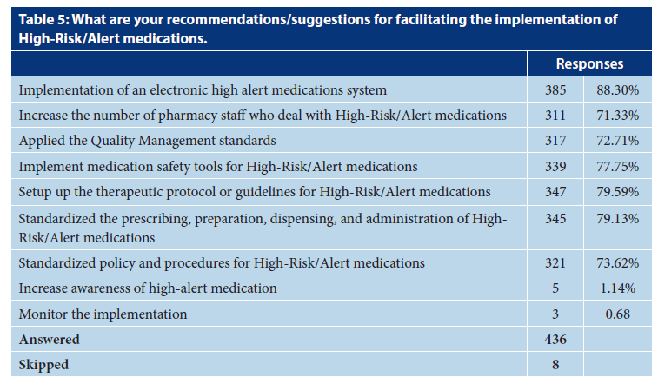

Slide 7
CONCLUSION:
The pharmacist’s perception of High-Risk/Alert medications was beneficial and supportive for improving high-quality performance. The pharmacist believes there is a high demand for standardized protocols for prescription, preparation, and administration stages of drug orders. Besides, the High-Risk/Alert medication is under-working of some High-Risk/Alert medications. The pharmacist lacks periodic education and training about High-Risk/Alert medications and lacks clinical background knowledge. Therefore, the electronic prescription of High-Risk/Alert drugs and electronic therapeutic protocol or guidelines of High-Risk/Alert medicines are highly recommended for implementation in pharmacy practice in Saudi Arabia.

