Slide 1
Perception of Pharmacists about Pharmacy Health Insurances Services in Saudi Arabia
Yousef Ahmed Alomi, Shaimaa O Ahmadeen, Maha Hussein Almadany, Mohammad Abdullah Alghamdi, Atheer Fahad Al-Aqile

Slide 2
ABSTRACT:
Objectives: To demonstrate the Perception of Pharmacist about Pharmacy Health Insurances Services in Saudi Arabia. Materials and Methods: It analyzes a crosssectional survey discussing Pharmacists’ Perceptions of Pharmacy Health Insurances Services in Saudi Arabia. The survey consisted of respondents’ demographic information about pharmacists, perception of pharmacists about health insurance, barriers, which factors may Discourage you from implementing health insurance medications, recommendations/suggestions for facilitating the implementation of high-risk medicines, and medications health insurance responsibility. The 5-point Likert response scale system was used with closed-ended questions. The survey was validated through the revision of expert reviewers and pilot testing. Besides, various tests of the reliability of McDonald’s ω, Cronbach alpha, Gutmann’s λ2, and Gutmann’s λ6 were done with the study. Furthermore, the data analysis of the Perception of Pharmacist about Health Insurances in pharmacy practice is done through the survey monkey system. Besides, the statistical package of social sciences (SPSS), Jeffery’s Amazing Statistics Program (JASP), and Microsoft Excel sheet version 16.

Slide 3
ABSTRACT:
Results: A total number of 398 pharmacists responded to the questionnaire. Of them, more than one-third responded from the Central region (137 (34.51%)), and one Quarter responded from the western part (109 (27.46%)), with statistically significant differences between the provinces (p=0.000). Males responded more than females (239 (60.35%)) versus 157 (39.65%)), with statistically significant differences between all levels (p=0.000). Most of the responders were in the age group of 24-30 years (271 (68.26%)) and 31-35 years (56 (14.11%)), with statistically significant differences between all age groups (p=0.000). Most of the pharmacists were staff pharmacists (300 (75.76%)) and pharmacy supervisors (43 (10.86%)), with statistically significant differences between all levels (p=0.000). Almost one-half of pharmacists currently have health insurance coverage (239 ((60.05%)) with equal or less than one year (108 ((42.52%)), or 2-3 years (81 ((31.89%)), have you been associated with your current insurance provider with statistically significant differences between all levels (p=0.000). The average score of perception of pharmacists about health insurance was (3.62). The element “The participation of pharmacists in Heath insurance system should be mandatory ” obtained the highest score (3.81). The aspect “The Heath insurance pharmacist can analyze the consumption of the medication at healthcare institutions” was (3.75). The average score for the element “factors may Discourage you from implementing Health insurance at pharmacy practice” was (3.27). The score for the component “The health insurance pharmacist was Not taught properly in pharmacy Schools ” was (3.59). The score for the element “Lack of Periodic training of pharmacy staff about the role of health insurance pharmacist ” was (3.57). Most staff responsible for medications and health insurance was Heath insurance Pharmacist (3.65) more than Heath insurance Doctors (2.90) or accountant (2.70), with a statistically significant difference between the responses (p<0.001). The recommendations/suggestions for facilitating the implementation of pharmacist health insurance were “Increase number of Heath insurance pharmacist staff “ 258 (69.07%) and “Implement of Heath insurance pharmacist at healthcare institutions” 252 (64.95%).

Slide 4
ABSTRACT:
Conclusion: The Perception of Pharmacists about Health Insurance in pharmacy practice is appropriate. The pharmacy insurance system demands administrative support. Removing the obstacles and increasing pharmacy staff in health insurance organizations are highly recommended in Saudi Arabia.

Slide 5
Key Words :
Perception,
Pharmacists,
About Pharmacy,
Health Insurances,
Services Saudi Arabia.

Slide 6
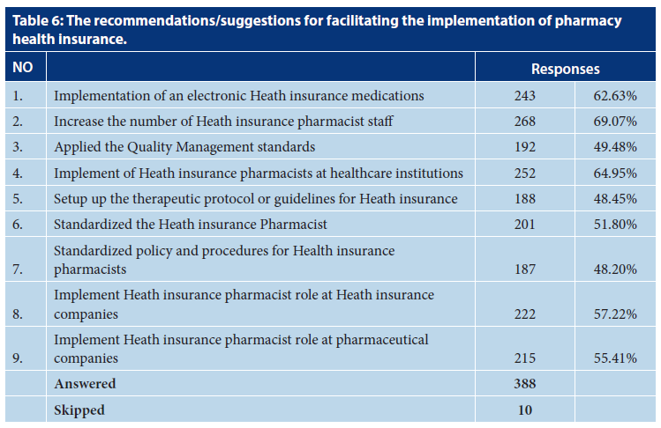

Slide 7
CONCLUSION:
The perception of pharmacists about pharmacy health insurance services was appropriate. The pharmacist believed that pharmacist involvement in Heath insurance should be mandatory and pharmacists should have an active role in drug Heath insurance services. However, the pharmacist faced several obstacles that prevented implementation, such lack of education and training for undergraduates and postgraduate scholarships. The responders believe that pharmacists should be responsible for pharmacy Health insurance. Besides, the pharmacist should take an active role in Heath insurance services, implement health insurance pharmacist policies, and involve drug Heath insurance within an electronic prescribing system in Saudi Arabia. Various factors might affect pharmacists’ perception of Heath insurance in pharmacy practice, such as work sites, positions of pharmacists, and length of health insurance coverage. The health insurance pharmacist should be unified and standardized in pharmacy practice at all Healthcare organizations and Heath insurance companies.

