Slide 1
Accounting and Financial in Pharmacy Practice: Managerial Accounting
Yousef Ahmed Alomi, Ghadeer Zayed Aljumah, Nasser Rashid Alohlie, Naif Saleh Alamri, Maha Hussein Almadany, Abeer Hussin Almasoudi, Riyadh M Alashban

Slide 2
ABSTRACT:
Objectives: To explore the managerial accounting policy and procedures in pharmacy practice as a new initiative in Saudi Arabia. Methods: It was a narrative review of the pharmacy practice’s managerial accounting policy and procedures. Litterateur searched various databases, including PubMed, Medline, and Google Scholar. The search period is from the 1960s until 15 October 2023. The term is in full-text English and includes Case Reports, Classical Articles, Clinical Conferences, Clinical Studies, Clinical Trials, Evaluation Studies, Government Publications, Guidelines, Meta-Analysis, Observational Studies, Practice Guidelines, Randomized Controlled Trials, Reviews, Systematic Reviews, with Humans subject. All hospital or community pharmacy services are included in a search term. Besides, the National and international guidelines of general infection control in hospital practice. The committee of pharmacy accounting policy and procedures formulated and consisted of various expert members. That includes clinical pharmacists, accountant specialists, and financial experts. The guidelines of the policy draft by one member by the second member were reviewed and corrected. The third revision was by the accountant specialist. The topic emphasizes managerial accounting of the Pharmacy policy.

Slide 3
ABSTRACT:
Results: The managerial accounting policy and procedures in pharmacy practice calculate the costs of products sold, working fees, labor costs, and other costs related to running a pharmacy. Managerial accounting in pharmacy practice can analyze the prices of various products and services, track sales revenue and profit margins, and improve pharmacy operations’ efficiency, effectiveness, and profitability. The steps of cost calculation policy and procedures were illustrated in the review. Conclusion: The managerial accounting policy and procedures in pharmacy practice is a new pharmacy management initiative. The managerial accounting policy and procedures in pharmacy practice can help pharmacy managers and administrators make effective financial decisions and plan pharmacy budgets and product pricing. Therefore, pharmacy career professionals in Saudi Arabia must implement the administrative-accounting policy and procedures in pharmacy practice.

Slide 4
Key Words :
Accounting,
Financial,
Policy,
Pharmacy,
Managerial Accounting,
Saudi Arabia.

Slide 5
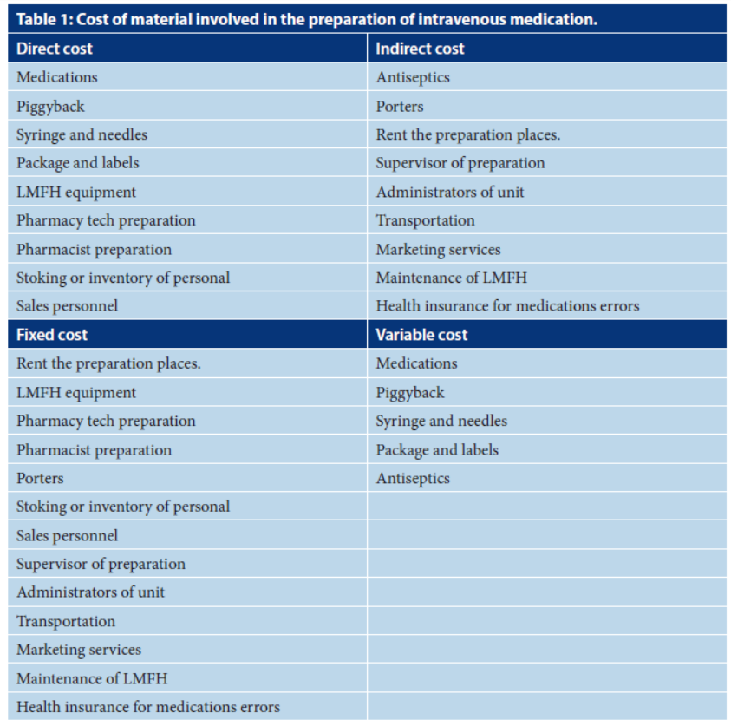

Slide 6
CONCLUSION:
The managerial accounting policy and procedures in pharmacy practice as a new initiative project of pharmacy administration services. It explores the price calculations of various products and operations of pharmacy services. Managerial accounting in pharmacy practice is a vital branch of accounting required for pharmacy managers and administrations used for effective and efficient pharmacy performances and operations. Besides, the monitoring of adherence to accounting standards and regulations. The managerial accounting policy and procedures in pharmacy practice are a sessional part of pharmacy management and highly demand pharmacy practice in Saudi Arabia.

