Slide 1
KSA-Self Assessments of Pharmacy Safety and Occupational Health
Yousef Ahmed Alomi, Badriya Mufflih Alrasheedi, Mohannad Ali Abu-Sabah, Naif Saleh Alamri, Abdulah Khalid Al-Otaibi, Mohammed Hakami, Areej Abdullah Al Jasser, Samah Mukhlef Alzaid, Rola AL Kenani, Huda Juhaim Alruwaili

Slide 2
ABSTRACT:
Objectives: To explore the KSA-Self Assessments of Pharmacy Safety and Occupational Health as a new initiative project in Saudi Arabia. Methods: It was a narrative review of KSA-Self Assessments of Pharmacy Safety and Occupational Health. Literature searched various databases, including PubMed, Medline, and Google Scholar. The search period is from the 1960s until 06 December 2023. The term is in full-text English and includes Case Reports, Classical Articles, Clinical Conferences, Clinical Studies, Clinical Trials, Evaluation Studies, Government Publications, Guidelines, meta-analyses, Observational Studies, Practice Guidelines, Randomized Controlled Trials, Reviews, Systematic Reviews, with Humans subject. All hospital or community pharmacy services are included in a search term. Besides, the National and international guidelines of general occupational safety and health in hospital practice. The committee of pharmacy accounting policy and procedures formulated and consisted of various expert members. That includes clinical pharmacists, occupational safety specialists, Crisis and Disaster Management, and fire safety experts. The self-assessment is based on guidelines based on occupational safety and health societies’ regulations. In addition to Institution Safe Medication Practice (ISMP) criteria and KSA-Self assessment of pain management drug safety. The policy draft by one member by the second member was reviewed and corrected. The third revision was by the occupational safety specialists. The topic emphasizes self-assessments of Pharmacy Safety and Occupational Health.

Slide 3
ABSTRACT:
Results: The KSA Self Assessments of Pharmacy Safety and Occupational Health consisted of nine items. That has included Characteristics of Pharmacy Services, Pharmacy and warehouse building, Fire Safety, Crises and Disaster Management. Besides the Medication Information, Pharmacy Safety Practice, Patient/Family Education, Pharmacy staff competency and training, and Total Quality and Risk Management. Each element had various closedended questions scored using the 5-point Likert response scale system. Conclusion: The KSA-Self Assessments of Pharmacy Safety and Occupational Health policy is a new initiative project in Saudi Arabia. The KSA-Self Assessments of Pharmacy Safety and Occupational Health policy improves the Pharmacy Safety and Occupational Health system foundations. In addition, it encourages pharmacists to adhere to Pharmacy Safety and Occupational Health regulations in different places in the public and healthcare organizations. Therefore, the KSA-Self Assessments of Pharmacy Safety and Occupational Health policy is highly recommended for pharmacy career professionals in Saudi Arabia.

Slide 4
Key Words :
Occupational health,
Self-assessment,
Pharmacy,
Safety,
Saudi Arabia.

Slide 5
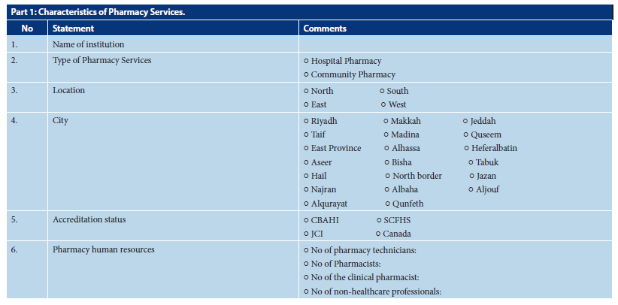

Slide 6
CONCLUSION:
The KSA-Self Assessments of Pharmacy Safety and Occupational Health is a new initiative for the overall performance of pharmacy occupational safety services. It is a significant equipment for the statistical administration of occupational injury prevention and works in pharmacy practice. It consisted of nine components: Characteristics of Pharmacy Services, Pharmacy and warehouse building, Fire Safety, and Crises and Disaster Management. Besides the Medication Information, Pharmacy Safety Practice, Patient/Family Education, Pharmacy staff competency and training, and Total Quality and Risk Management. The method can assess the pharmacy organization gap problems analysis and improve pharmacy occupational safety culture. The KSA-Self Assessments of Pharmacy Safety and Occupational Health are especially cautioned to put into effect in pharmacy occupational safety operation exercises in Saudi Arabia.

