Slide 1
National Workload Analysis of Network of Drug Information Centers at Ministry of Health Hospitals in Saudi Arabia
Yousef Ahmed Alomi, Saeed Jamaan Alghamdi, Radi Abdullah Alattyh

Slide 2
ABSTRACT:
Objectives: To analyze the workload of the network of drug information centers at the Ministry of Health institutions, Saudi Arabia.
Methods: This is a 2-month cross-sectional survey of all drug information centers at MOH hospitals. Any drug information center that has been recently opened or has provided services to the healthcare professionals and the public participated in the survey. The national, regional, and local drug information centers at healthcare institutions were included in the survey. In addition, hospitals or primary care centers (e.g., public, pediatric, maternity, and psychiatry) were also included in the survey. The survey consisted of two parts: demographics data and workload of drug information centers. The clinical activities were driven by the American College of Clinical Pharmacy model.

Slide 3
Results: The questionnaire was distributed to around 60 drug information centers. A total of 46 centers responded to the questionnaire, with a response rate of around 76.66%. Most hospitals (11 (23.9%)) had 100–199 beds and others (11 (23.9%)) had 200–299 beds. A total of 1022.5; 22,495; and 269,940 drug information queries were received daily, monthly, and annually, respectively. The greatest demand for a full-time employee (FTE) to preform drug information activities was at the central drug information activities (20.95 FTE) followed by the administration-related drug information activities (17.98 FTE) and patient-specific drug information activities (8.41 FTE). Among the central drug information activities, the highest amount of activity was observed for in-service training (10.95 FTE), whereas among the administration-related drug information activities, the highest amount of activity was observed for attending lectures/courses/symposium/training (2.46 FTE). Among the patient-specific drug information activities, the highest amount of activity was observed for patient counseling services (3.43 FTE).

Slide 4
Conclusion: The workload of drug information centers was found to be very high. The services were needed to be revised within basic and advanced requirements of drug information centers at the Ministry of Health, Saudi Arabia.

Slide 6
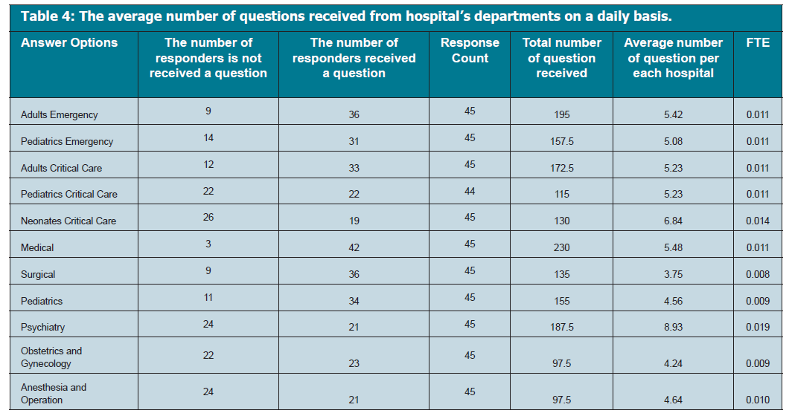

Slide 7
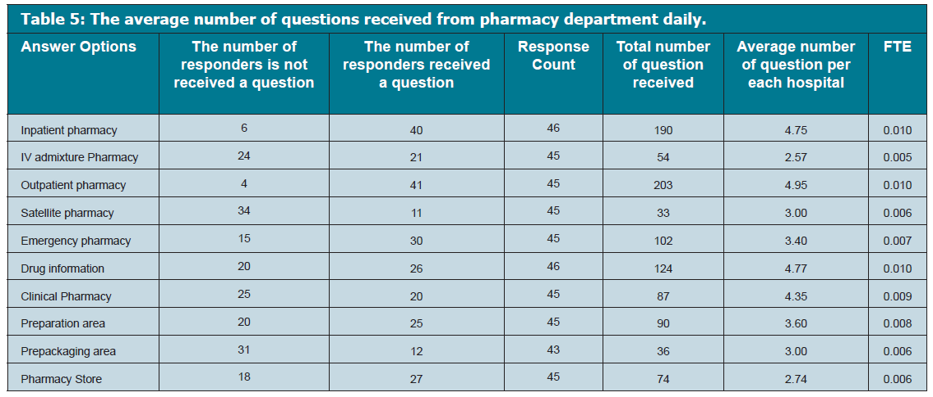

Slide 8
CONCLUSION
Despite the high workload of drug information services, there is a great demand for personnel related to human resources, facilities, and financial support. Targeting to review all requirements of drug information services is highly recommended at MOH in Kingdom of Saudi Arabia.

