Slide 1
National Survey of Drug Information Centers’ practice: Evidence-Based Medicine-Therapeutics Guidelines
(EBM-TG) System at Ministry of Health hospitals in Saudi Arabia
Yousef Ahmed Alomi, Saeed Jamaan Alghamdi,
Radi Abdullah Alattyh

Slide 2
ABSTRACT:
Objective: To explore the practice at the National Survey of Drug Information Centers in Saudi Arabia with an emphasis on Evidence-Based Medicine-Therapeutics Guidelines (EBM-TGs) System at Ministry of Health hospitals.
Methods: This is a 4-month crosssectional national survey of the Drug Information Services at MOH. The survey contains 10 domains with a total of 181 questions designed by the authors. The questions were derived from the International Pharmaceutical Federation, American Society of Health-System Pharmacists best practice guidelines. The survey was distributed to 40 hospital pharmacies that run drug information services. In this study, the domain Medication-Use Evaluation System was explored and analyzed. It consisted of seven questions about the written policies and procedures and application methods for EBM-TG in the drug information centers. The data were analyzed through the Survey Monkey system.

Slide 3
Results: The response rate was found to be around 88.88%. According to the results, written policies and procedures for EBM-TGs existed only in 18 (45%) hospitals and approximately 25–100% of the elements implementations. EBM-TG monitoring system is available live in only 17 (42.5%) hospitals applying approximately 25–100% of the elements. According to our results, in only 18 (45%) hospitals, the patients receive appropriate care due to EBM-TGs. There is evidence that the EBM-TG Indicators existed in only 19 (45.5%) hospitals applying approximately 25–100% of the elements. Process for improving EBM-TG system exists in 20 (50%) hospitals applying approximately 25–100% of the elements.
Conclusion: There a poor application of EBM-TGs in the practice of drug information centers. Implementation of EBM-TG system improves patient outcomes which avoids unnecessary additional costs in the healthcare system.

Slide 4
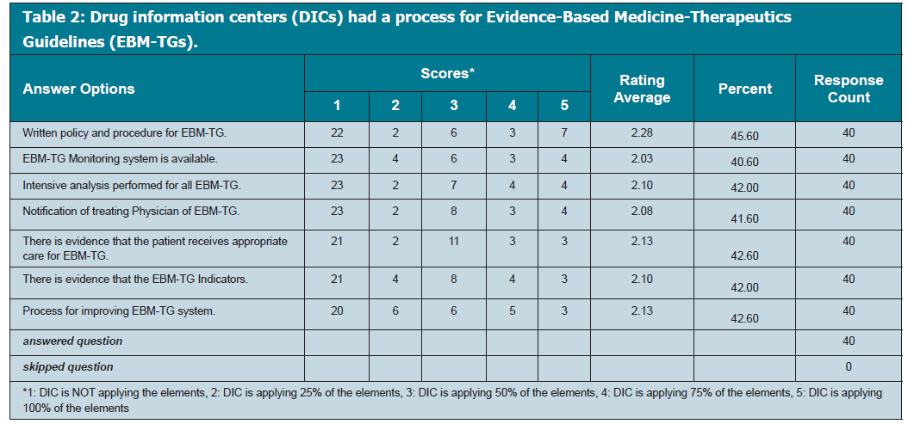

Slide 5
CONCLUSION
EBM-TGs are a new concept in the pharmacy field of DICs practice. Systemic implementation of EBM-TGs with education and training, close monitoring, and repeating the survey of the application of such new system improves DICs services and may prevent economic burden in the healthcare system at MOH hospitals in KSA.

