Slide 1
Pharmacist’s Perception of Pharmacovigilance and Reporting of Adverse Drug Reactions in Saudi Arabia
Fatima Fouad Al Dougahn

Slide 2
ABSTRACT:
Background: Pharmacists’ perception toward their role in reporting of Adverse Drug Reactions (ADRs) and their understanding of the importance of reporting ADRs are essential keys to be assessed and studied in order to determine the factors that may predispose to underreporting of ADRs in Saudi Arabia. Therefore, in this study, we aimed to asses and compare the perception of community and hospital pharmacists toward reporting of ADRs in different regions of Saudi Arabia. Method: A structured, validated questionnaire was used to conduct a cross-sectional study. A total of 263 pharmacists were enrolled. The questionnaire included the demographic data of the pharmacists and 11 questions to measure pharmacists’ perceptions of ADRs reporting of reporting ADRs. All statistical analysis done by using Statistical Package for the Social Sciences (SPSS) version 21 and Survey Monkey system.

Slide 3
ABSTRACT:
Results: The result shows that community and hospital pharmacists strongly agree about that reporting of ADRs allow to measure the incidence of ADRs 29 (55.77%), 121 (58.45) and to identify previously unrecognized ADRs 30 (57.69%), 116 (56.59%) and enable safe drugs to be identified 39 (70.91%), 129 (62.32%), respectively with no significant difference (p>0.05). Besides, both hospital pharmacists 116 (55.77%) and community pharmacists 31 (60.78%) strongly agree about their important role in the pharmacovigilance system. However, only 67 (32.52%) of hospital pharmacists strongly agreed about the physician’s responsibility in reporting ADRs compared to community pharmacists 29 (52.73%) with a significant difference between groups (p<0.05). However, 37 (17.87%) of hospital pharmacists were uncertain about drug companies’ role in pharmacovigilance system with a significant difference between community pharmacists with (p<0.05).

Slide 4
ABSTRACT:
Conclusion: The result of this study demonstrated that both community and hospital pharmacists among Saudi Arabia had a very goods of perception about the importance of ADRs reporting and their role in reporting ADRs.

Slide 5
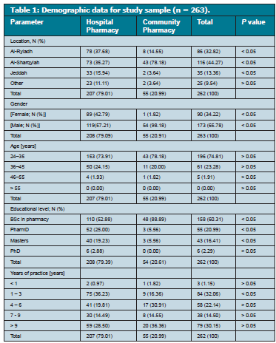

Slide 6
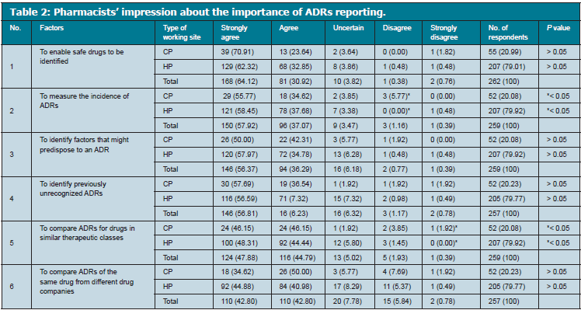

Slide 7
CONCLUSION:
Both community and hospital pharmacists in Saudi Arabia participated in this study were aware of their essential role in reporting ADRs as well as they genuinely understand the purpose of reporting ADRs.

