Slide 1
Perceptions and Knowledge of Storing Medications at Home in Al-Qassim Region, Saudi Arabia
Afaf Badr Alenazi, Mansour Saleh Alsharidah, Amal Hassan Al-Najjar, Suliman Abdulaziz Alghazy, Abdul-Aziz Abdullah Alqadi, Amir Marzouk

Slide 2
ABSTRACT:
Objective: Globally people store medications at home, which is also common among the residents of Al-Qassim Region, Saudi Arabia. They should be stored safely to prevent the accidental ingestion or unintended use. However, the method of storing medications at homes in Al-Qassim region, Kingdom of Saudi Arabia is unknown. Therefore, in this study, we aimed to explore the perception and knowledge of medications stored at Al-Qassim region, Saudi Arabia. Methodology: This is a descriptive, cross-sectional survey which was conducted through the random distribution of a pre-validated structured questionnaire with the public and private sector employees and with general population from all walks of life above the age of 18 years in Al-Qassim region. The survey was designed electronically through the Survey Monkey system and was distributed through social media.

Slide 3
ABSTRACT:
Results: A total of 708 participants responded to this survey. Most of the responders (485 (68.10%)) were females. About half of the responders were in the age group of 18–29 years (393 (58.31%)) with a significantly dominant female population compared to males (p<0.05). Most of the responders checked or almost checked the instructions of storing medications (192 (28.24%) and 273 (40.15%), respectively) without any significant difference between education level (p>0.05). Most of the responders checked the expiry date of stored medications (496 (70.06%)). Most of the responders did not receive instructions on storage of medications from pharmacist or physician (597 (84.32%)). Most of the resources regarding storage of medications were obtained from the physician (388 (54.8%)), drug leaflet (320 (45.2%)) followed by pharmacist (318 (44.92%)) and self-learned (154 (21.75%)). Therapeutic classes of stored medication were analgesics and antipyretics (322 (41.87%)) followed by cardiovascular drugs (64 (8.32%)) and oral anti-diabetic drugs (58 (7.54%)).

Slide 4
ABSTRACT:
Conclusion: The results of this study showed that people at Al-Qassim region tend to store medication at home not just over the counter medications but also medications of chronic illnesses. They should be educated on the need of medications, safety of medications and requirements of storing medications at home. Educational activities should be conducted through all possible channels to increase the awareness and to educate people on the proper method of storing medications.

Slide 5
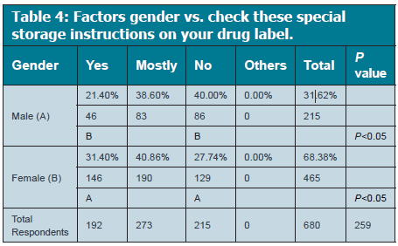

Slide 6
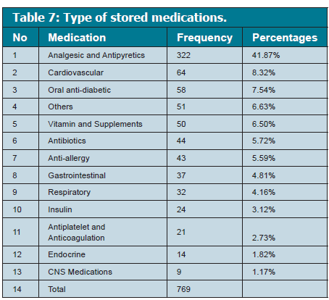

Slide 7
CONCLUSION:
This study depicts several different factors responsible for such a large proportion of unused medications in the households. Women can be the source of driving this change as they manage the health issues and medicine of their family. This study also suggests that people can be most readily influenced by the physicians and pharmacists to incorporate positive changes. They should be made aware of this issue and should be motivated to make patients aware of the risks of improper disposal and self-medication. These two channels can have the most promising results in increasing awareness about the proper storage and disposal of medications.

