Slide 1
Assessment of Patient Satisfaction with Pharmaceutical Services in Ministry of Health Hospitals at East Province, Saudi Arabia
Mohammed Mohsen Almaznai, Osama Mohammed Almadani, Ibrahim Abdul Karim Aloraifi, Saleh Ali Alsallouk, Hussain Alkabaz, Mohammed Saud Alotaibi, Hamdi Abdullah Alamri, Kairat Imad Al-Hennawi, Mohanad Imad Al-Hennawi, Yousef Ahmed Alomi

Slide 2
ABSTRACT:
Objective: Patient satisfaction is considered as a measure of the quality of care in health system. Investigation of satisfaction with pharmaceutical services will disclose gaps in training and barricades of implementation. The study examined patient satisfaction of pharmaceutical services at Ministry of Health Hospitals at East Province in Saudi Arabia. Methods: It is a 4-months cross-sectional self-administered survey of patient satisfaction of pharmaceutical care in Ministry of Health Hospitals at East Province, Saudi Arabia. The survey comprises two parts; the first part was demographic data about the patients, the second part was several domains about various pharmaceutical care services at East Province in Saudi Arabia. The 5-point Likert response scale system used with closed and ended questions. The survey scattered through five hospitals in East Province involved a public, pediatrics, maternity and psychiatry hospitals ambulatory care patient. All data and variables analyzed by Microsoft Excel program version 10.

Slide 3
ABSTRACT:
Results: The study sample size was 892. Out of 892 patients, 815 (95.66%) was Saudi and 37 (4.34%) was non-SaudiSaudi. Of that 213 (25%) was female and 639 (75%) was male. The majority of patients were between the ages of 20-40 (61.33%) and 41-60 years (39.44%) old. The average score of pharmacy location and related issues was 3.69/5.00. The domain of pharmacy location was ranked highest (4.05/5.00), while the domain of pharmacy waiting area was ranked lowest (3.47/5.00). The average score of medication related issues was 4.28/5.00. The domain of the drug label stickled with all medications was ranked highest (4.43/5.00), while the domain of the medication reconciliation was ranked lowest (3.56/5.00). The average score of pharmacist related issues was 4.66/5.00. The domain of the pharmacist assure by your name before dispensing was ranked highest (4.58/5.00), while the domain of the pharmacist provides you with medication counseling and encourages you to ask questions was ranked lowest (3.91/5.00). The overall pharmacy evaluation was 4.55/5.00. Conclusion: The patient satisfaction of pharmacy services was adequate at MOH hospital in East Province, Saudi Arabia. The outcomes showed a lack in pharmacists ‘interaction with patients and exertions should be focused towards involvement in a more patient-oriented training in Saudi hospital pharmacies.

Slide 4
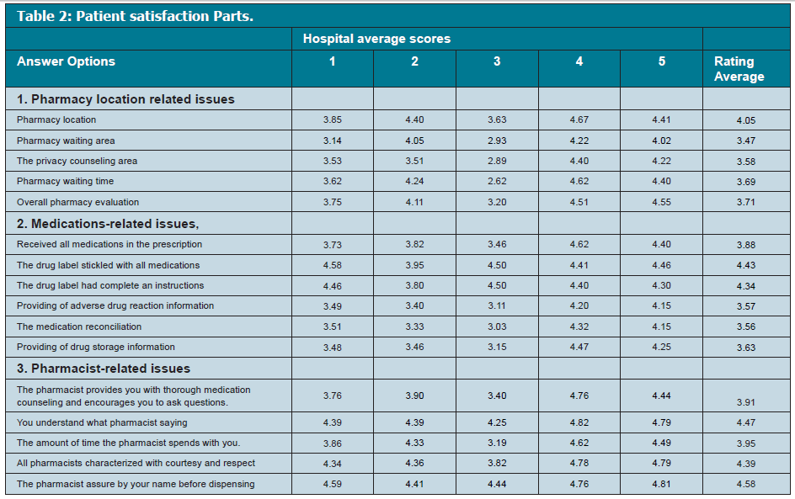

Slide 5
CONCLUSION:
Pharmaceutical services were found to be within an adequate level of satisfaction. Patient satisfaction with pharmaceutical care system is a crucial tool to follow up the execution of strategic planning of General Administration of Pharmaceutical Care in Saudi Arabia. The patient satisfaction of ambulatory care pharmacy services was acceptable. Pharmacy staff (particularly clinical pharmacists) should be more involved in patient counseling. The annual or every two years survey of pharmacy satisfaction tool is required at MOH hospital, East province in the Kingdom of Saudi Arabia.

