Slide 1
Patient Satisfaction of Ambulatory Care Pharmacy Services in Pediatric and Maternity Hospital in Riyadh City, Saudi Arabia
Yousef Ahmed Alomi, Malika Alshamari, Hawazen Abdullah Al-Kammash, Aroub Alhamidi, Walaa Aboziad, Kairat Imad Al-Hennawi, Mohanad Imad Al-Hennawi

Slide 2
ABSTRACT:
Objective: The ambulatory pharmacy practice is a crucial part of the healthcare system that delivers pharmaceutical care to the patients who are not admitted to the hospital. The aim of the study to explore the patient satisfaction of ambulatory care pharmacy services in Pediatrics and Maternity Hospital in Riyadh, Saudi Arabia. Methods: This is a 4-month cross-sectional survey of patient satisfaction of ambulatory care pharmacy services in Pediatrics and Maternity Hospital, Saudi Arabia. The survey consisted of forty-eight (48) questions divided into two parts: the first part collects demographic information and the second part contains questions on 11 domains: (1) medication availability, (2) patient counseling, (3) pharmacist and patient relationship, (4) medication reconciliation, (5) medication aberrance, (6) pharmacy location, (7) pharmacy waiting area, (8) pharmacy communications, (9) pharmacy waiting time, (10) pharmacy recommends to others, (11) overall patient satisfaction of pharmacy services. The survey was distributed to the hospitals in Riyadh city, included pediatrics and maternity hospitals ambulatory care patient. The survey was in an electronic format and it analyze the results through the Survey Monkey system.

Slide 3
ABSTRACT:
Results: A total of 237 patients responded to the survey. Out of 237 patients, 217 (91.6%) was Saudi and 20 (8.4%) was non-Saudi. There were 151 (63.7%) female and 86 (36.3%) male responders. Most of them were in age group of 18-44 years (70%) without any significant differences in the age groups among the hospitals. The highest level of education was high school 91 (38.4%) followed by the Bachelor’s degree 93 (39.2%) and an intermediate school 44 (18.6%). The mean [±standard deviation (SD)] waiting time to get the medications was 13.6±4.75 min. The average scores of domains 1, 2, 3, 4, 5, 6, 7, 8, 9 and 10 were 3.11, 3.1, 3.61, 1.87, 1.72, 3.4, 2.77, 1.93, 3.68 and 3.56, respectively. With a total of 231 (97.4%) responders, general evaluation of pharmacy services was found to be very good to excellent, whereas 228 (96.2%) responders recommend the pharmacy to their family or friends and 224 (95.3%) responders prefer to revisit pharmacy. Conclusion: More than two-thirds of the patients were pleased with ambulatory care pharmacy services at Riyadh, Saudi Arabia. Medication reconciliation, medication adherence and pharmacy waiting area domains were not found to be satisfied. Improving ambulatory care pharmacy services will avert drug misadventures, avoid additional cost and surge patient satisfaction with pharmacy services.

Slide 4
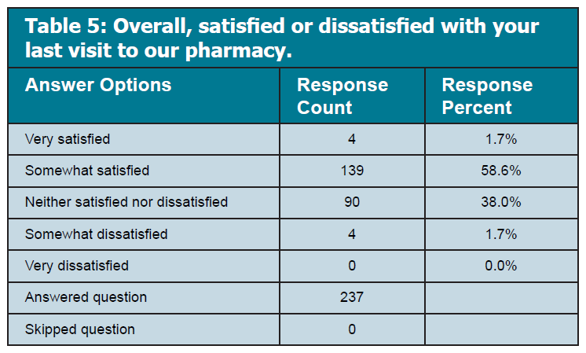

Slide 5
CONCLUSION:
Although patient fulfilment of pediatrics and maternity ambulatory care pharmacy services surpasses more than two-thirds of the responders, there were several domains that need to be enhanced to reach an ideal level of patient satisfaction. More than two-thirds of the patients were pleased with ambulatory care pharmacy services at Riyadh, Saudi Arabia. This means medication reconciliation, medication adherence and pharmacy waiting area domains need additional enhancement. Improving pediatrics and maternity ambulatory care pharmacy services will avert drug misadventures, avoid additional cost and surge patient satisfaction with pharmacy services.

