Slide 1
National Survey of the Pharmacokinetics Services at the Ministry of Health Hospitals in Saudi Arabia: Drug Therapy Monitoring and Healthcare Professional Education
Yousef Ahmed Alomi, Rasha Abdelsalam Elshenawy, Sultan Mohammed Al-Jarallah

Slide 2
ABSTRACT:
Objectives: A clinical pharmacist offers vital support in the expansion of a final prescription with improved patient management and enhanced safety. The aim of the current study to explore the Pharmacokinetics services at Ministry of Health (MOH) hospitals in Saudi Arabia with an emphasis on drug therapy monitoring and patient’s education. Methods: This is a 2-months cross-sectional national survey related to the Pharmacokinetics services with a focus on drug therapy monitoring and education of pharmacist at MOH hospitals in Saudi Arabia. The study consisted of two parts; the first part captures demographic information and the second part contained 43 questions designed by the authors. It was derived from American Society of Health-System Pharmacists (ASHP) guidelines and from the literature. We used the 5-point Likert response scale system to obtain responses of the participants; there were close-ended questions. The electronic questionnaire was distributed to all the coordinators of the clinical pharmacy services or to the drug information centers at MOH hospitals. All analysis was done through survey monkey system.

Slide 3
ABSTRACT:
Results: A total of 43 hospital pharmacies returned the survey, for a response rate of 86%. The most clinical pharmacokinetics services documented were drug quality reporting 34 (87.18%), drug information inquiries 35 (83.33%), adverse drug reaction 35 (81.40%) and medication error 35 (81.40%). Highest clinical impact and cost avoidance of clinical Pharmacokinetics services were drug information inquiries 25 (60.98%), the drug quality reporting system 21 (53.85%) and pharmacist intervention 21 (52.5%). Analysis of monthly workload for clinical Pharmacokinetics services were a number of drug information inquiries 28 (70%) and the number of prescriptions needs 25 (64.1%). The clinical Pharmacokinetics services education and training for pharmacists were found at average 7.8 (20.89%) hospitals with high percentages type of educations was short education course 1-5 days [15 (39.47%)] and long training course 4-5 weeks [8 (21.05%)]. While Pharmacokinetics services education and training for healthcare provider were found at main 6 (15.66%) hospitals only with high percentages type of educations was short education course 1-5 days [8 (20.00%)] and Pharmacokinetics competencies 7 (18.92%).

Slide 4
ABSTRACT:
Conclusion: Pharmacokinetics services on drug therapy monitoring was not competent at half MOH hospital, while only few of the hospitals had pharmacokinetics education and training to offer. Implementing the MOH pharmacokinetics services strategy with an emphasis on the drug therapy monitoring with education and training is required at all MOH hospitals in Saudi Arabia.

Slide 5
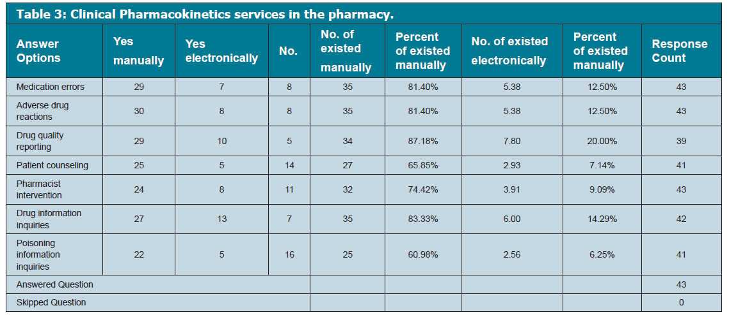

Slide 7
CONCLUSION:
Drug therapy monitoring during Pharmacokinetics services was not competent at MOH hospital. Only few of the hospitals had pharmacokinetics education and training to offer. There is the need to increase the number of clinical pharmacists who are specialized in this field with a focus on pharmacokinetics education and training at MOH hospitals in KSA.

