Slide 1
Forecasting (2018-2030) and the Demand of Hospital Pharmacy Technician Workforce at Over Twelve Years (2006-2017) in Saudi Arabia
Yousef Ahmed Alomi, Saeed Jamaan Alghamdi,
Radi Abdullah Alattyh

Slide 2
ABSTRACT:
Objectives: The workforce of hospital pharmacy technician is one the elements of pharmacy strategic plan in Saudi Arabia.: The purpose of this study is to explore the demand workforce of pharmacy technician at MOH hospitals over the past twelve years (2006-2017) and forecasting during (2018-2030) in the kingdom of Saudi Arabia. Methods: It is a retrospective analysis of twelve years (2006-2017) of Ministry of Health pharmacy technician workforce demand and forecasting in the future (2018-2030) at MOH organization practice. All data were derived from the Ministry of Health Statistical Year Books and any missing appropriate information about pharmacy technician workforce that will be estimated through allied healthcare professional’s data in each region including gender or nationality. It included pharmacy technician and exclude all types of pharmacists or clinical pharmacist’s workforce at MOH hospital setting. All calculations were based on MOH workforce standards of hospital with update literatures. All calculation was done used Microsoft Excel version ten.

Slide 3
ABSTRACT:
Results: The number of pharmacy technician demand based on optimum pharmacy and pharmacist. The pharmacy technician ratio (1:4) demand was (21,212.6-26,091) with an average (22,934.68). While with a ratio of (1:2) the number of pharmacy technician demand was (7,410-8,859) with an average (8,320.55). The number of pharmacy technician forecasting of a ratio (1:3) was (14,300-17,475) with an average (15,627.62). The forecasting number of pharmacy technician in the future within years (2018-2030) over thirteen years based on optimum pharmacy and pharmacist. The pharmacy technician ratio (1:4) forecast was (33,898.6-45,803) with an average (39,577.00). While with a ratio of (1:2) the number of the forecasting pharmacy technician was (16,303-22,028) with an average (19,034.31). The number of pharmacy technician forecasting of ratio (1:3) was (25,100 - 33,916) with an average (29,305.54). Conclusion: The demand of pharmacy technicians and forecasting in the future were determined. The ratio of pharmacist to pharmacy technician in the hospital practice should be standardized. An annual study on hospital pharmacy technician workforce is recommended in Saudi Arabia.

Slide 4
Key Words :
Demand,
Forecasting,
Hospital,
Pharmacy technician,
Workforces,
Ministry of Health,
Saudi Arabia.

Slide 5
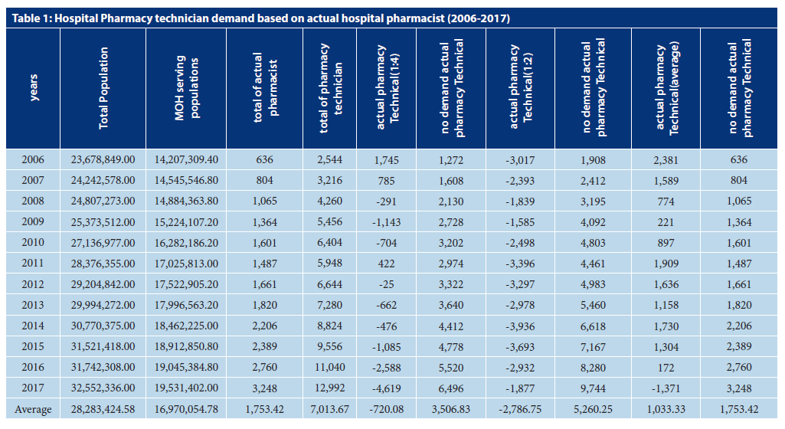

Slide 6
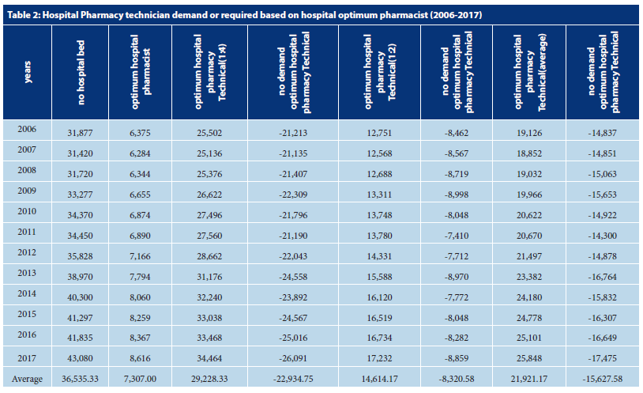

Slide 7
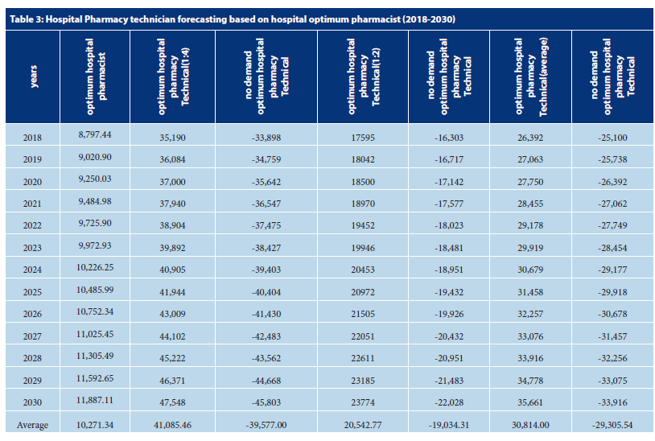

Slide 8
CONCLUSION:
The study of demand and forecasting of pharmacy technician workforce is unique locally and Gulf and Middle East countries. The standardized ratio of pharmacist to pharmacy technician at hospital practice should be determined. The periodically pharmacy technician workforce’s demand and forecasting at all healthcare organization is recommended in the Kingdom of Saudi Arabia.

