Slide 1
Demand for Pharmacy Technician Workforce at Primary Healthcare Centers during the Past 12 Years (2006–2017) and in the Future
(2018–2030) in Saudi Arabia
Yousef Ahmed Alomi, Saeed Jamaan Alghamdi,
Radi Abdullah Alattyh

Slide 2
ABSTRACT:
Objective: To explore the demand of pharmacy technician workforce at Ministry of Health’s (MOH) Primary Healthcare Centers (PHCs) over the past 12 years (2006–2017) and in the future (2018–2030) in the Kingdom of Saudi Arabia. Methods: This is a retrospective analysis of the demand of MOH’s pharmacy technician workforce during the past 12 years (2006-2017) and in the future (2018-2030). All data were derived from the MOH’s Statistical Year Books and any missing information regarding the pharmacy technician workforce will be estimated through allied healthcare professionals’ data from each region including data on gender or nationality. It included pharmacy technician and excluded all types of pharmacists or clinical pharmacist’s workforces at MOH hospital setting. All calculations were based on MOH’s workforce standards of PHCs and updated literature. All calculations were performed using Microsoft Excel version 10.

Slide 3
ABSTRACT:
Results: The demand for number pharmacy technicians based on the pharmacist: pharmacy technicians in the ratio standard (1:3) was (4–1,392) with an average number of (608.92) pharmacy technicians required. The demand for number of pharmacist: pharmacy technicians in the ratio standard (1:4) was (37,453–46,058) with an average number of (41,611.17) pharmacy technicians required. While the demand for pharmacist: pharmacy technicians in the ratio standard (1:2) was (18,281–22,218) with an average of (20,159.67). The number of pharmacist: pharmacy technicians required in the future based on the ratio standard (1:3) was 27,867–34,138 with an average number of (30,885.42) pharmacy technicians required. In the future (2018–2030), the pharmacist: pharmacy technicians based on the ratio standard (1:4) was (47,600–64,317) with an average of (54,895.23) pharmacy technicians required. However, the pharmacist: pharmacy technicians based on the ratio standard of (1:2) was (23,154–31,286) with an average number of (26,689.30) pharmacy technicians required. The number of pharmacist: pharmacy technician required based on the ratio standard (1:3) was (35,377–47,802) with an average number of (40,792.27) pharmacy technicians required. Conclusion: In this study, the demands and future forecasting of pharmacy technician workforces was determined. The pharmacist to pharmacy technician ratio should be standardized. Pharmacy technicians may be utilized at community pharmacies in the future. Periodic analysis of demand and forecasting at PHCs is highly recommended in Saudi Arabia.

Slide 4
Key Words :
Demand,
Forecasting,
Primary Healthcare Center,
Pharmacy Technician,
Workforce,
Ministry of Health,
Saudi Arabia.

Slide 5
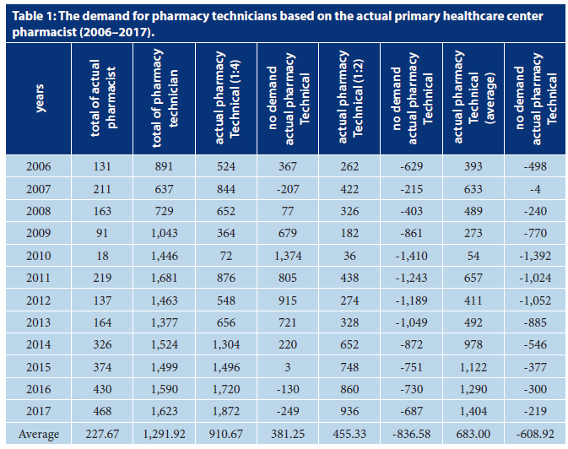

Slide 6
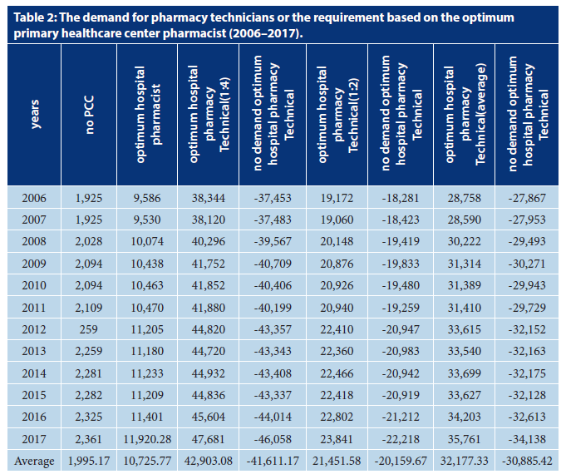

Slide 7
CONCLUSION:
The investigation of pharmacy technician workforces with an emphasis on demand and forecasting in the future is first done locally and Middle East. The pharmacy manpower of pharmacy technician and the ratio of pharmacist to pharmacy technician at primary healthcare should be standardized. Further studies demand to be investigated with actual demand based on the workload at PHCs is highly recommended in the KSA.

