Slide 1
Cost Analysis of Clinical Compounding in Saudi Arabia: Anticonvulsant Pediatrics Formulations
Yousef Ahmed Alomi, Malika Alhadab, Faiz A. Bahadig,
Mona Lubbad, Ebtesam Nazal,
Khulud Khalid Alnami

Slide 2
ABSTRACT:
Objective: The aim of this study is to explore the cost analysis of pediatrics anticonvulsant formulations in Saudi Arabia. Methods: It is a retrospective cost analysis of pediatrics formulations at 300-beds pediatrics and maternity hospital in Riyadh city, Saudi Arabia. The pharmacy section received the specific formulation from physician then the expert pharmacist applied the international standard of clinical compounding through of providing to healthcare staff over eight hours per days for five days per a week. The pediatrics formulations consisted of selected four anticonvulsant medications. The analysis of the cost included the variable expenses included personal cost, material and supply cost, Costs fixed including direct cost, non-salary cost and overhead cost. The cost was derived from the Ministry of Health information database. All cost was used US dollar currency. The study analyzed the cost of anticonvulsant pediatrics formulations through the Microsoft Excel sheet version 10th.

Slide 3
ABSTRACT:
Results: The estimated average total standard cost of pediatrics formulations per hour was (53.82 USD. The average estimated cost of Levetiracetam per each one preparation was (53.313 USD). The total annual cost of Levetiracetam was (18,126.42 USD). The average estimated cost of Topiramate per each one preparation was (22.66 USD). The total annual cost of Topiramate was (1,087.68 USD). The average estimated cost of Rufinamide per each one preparation was (29.342 USD), while the total annual cost of Rufinamide was (293.42 USD). Conclusion: This is the first study about cost analysis of anticonvulsant pediatrics formulations in KSA and Middle East. There are some differences in the cost analysis between the pharmacy preparations and manufactured related to internal and external reasons. The pharmacist should select the cheapest one among them the preparations. The cost analysis of pediatrics formulation meets the Saudi vision 2030 strategic plan in the Kingdom of Saudi Arabia.

Slide 4
Key Words :
Cost,
Clinical,
Compounding,
Anticonvulsant,
Pediatrics,
Formulations,
Ministry of Health,
Saudi Arabia.

Slide 5
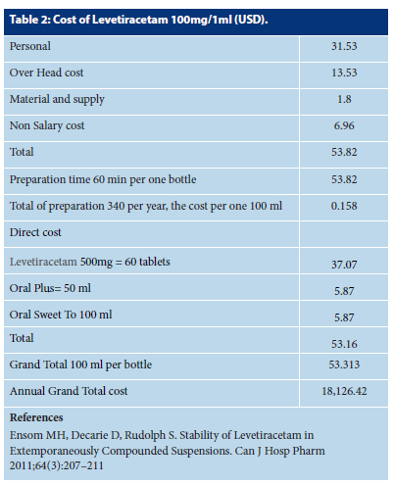

Slide 6
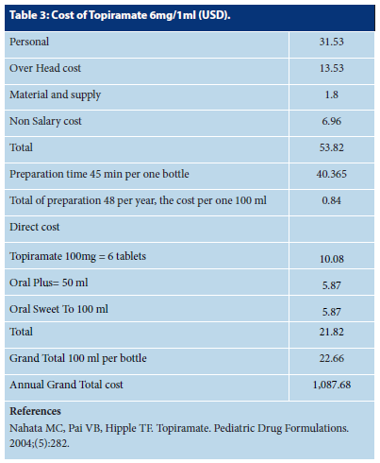

Slide 7
CONCLUSION:
The most oral pediatrics formulation of old medications of commonly used anticonvulsant is available in the local and international market. Pediatric formulations need to be suitable for the child in terms of dose, suitability and adequacy to ensure obedience with the medication. However, the oral pediatrics formulation of new medication is not available in the market, including the prices. The extemporaneous preparation of new products for pediatrics and analysis of the cost is beneficial for the patients and the pharmacy department. The cost analysis of all pediatrics anticonvulsant formulation is required in the hospital practice and meet pharmacy strategic plan with new Saudi vision 2030 in the kingdom of Saudi Arabia.

