Slide 1
Cost Analysis of Clinical Compounding in Saudi Arabia:
Oral Electrolyte Pediatrics Formulations
Yousef Ahmed Alomi, Faiz A. Bahadig,
Malika Alhadab, Mona Lubbad,
Ebtesam Nazal

Slide 2
ABSTRACT:
Objective: To explore cost analysis of selected oral electrolytes pediatrics formulations in the Kingdom Saudi Arabia. Methods: It is a retrospective cost analysis of pediatrics formulations at 300-beds pediatrics and maternity hospital in Riyadh city, Saudi Arabia. The pharmacy section received the specific formulation from physician then the expert pharmacist applied the international standard of clinical compounding through of providing to healthcare staff over eight hours per days for five days per a week. The pediatrics formulations consisted selected four selected electrolytes. The analysis of the cost was included the variable expenses like personal cost, material and supply cost. Fixed costs include direct cost, non-salary cost and overhead cost. The cost was derived from the Ministry of Health information database. All cost was used US dollar currency. This study analyzed the cost of anti-hypertension pediatrics formulations through the Microsoft Excel sheet version 10th.

Slide 3
ABSTRACT:
Results: The estimated average total standard cost of pediatrics formulations per hour was (53.82 USD). The average estimated cost of potassium chloride 10% per each preparation was (2.053 USD) and the total annual cost of potassium Chloride 10% was (172.452 USD). The average estimated cost of potassium chloride 7.5% per each preparation was (1.342 USD) with the total annual cost of potassium chloride 7.5% was (228.14 USD). The average estimated cost of sodium bicarbonate 8.4% per each preparation was (0.7551 USD) with the total annual cost of sodium bicarbonate 8.4% was (54.36 USD). The average estimated cost of calcium carbonate 200 mg/mL per each preparation was (5.45 USD) with the total annual cost of calcium carbonate 200mg/mL was (1,046.4 USD). The average estimated cost of sodium chloride 5.8% per each preparation was (1.117 USD) which the total annual cost of sodium chloride 5.8% was (167.55 USD). Conclusion: Most the electrolyte pediatrics formulations which are not available in the local or international market. Pharmacists should continue to prepare them with lower economic burden. The study was first done in KSA and meet new health strategic plan of Saudi vision 2030 in the Kingdom of Saudi Arabia.

Slide 4
Key Words :
Cost,
Clinical,
Compounding,
Electrolyte,
Pediatrics,
Formulations,
Ministry of Health,
Saudi Arabia.

Slide 5
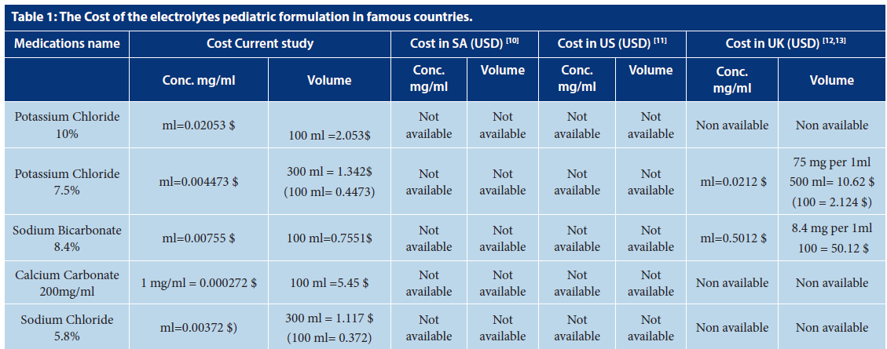

Slide 6
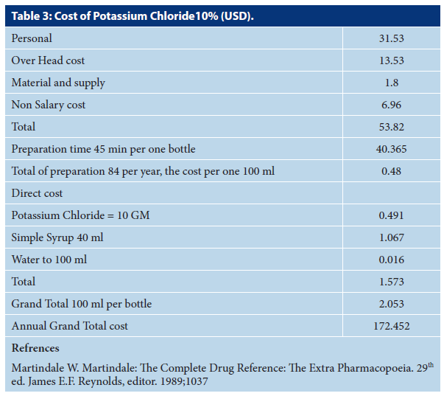

Slide 7
CONCLUSION:
The total parental nutrition is essential services for neonates and pediatrics. Besides, enteral nutrition is the next steps of oral feeding. Some of oral pediatrics formulation may be required for neonatal disease and crucial electrolyte among them. Most of the oral electrolyte pediatrics formulation is not available in the market. The extemporaneous preparation of oral Electrolyte and cost related is essential for medication availability and subsequently, the patient satisfaction. The cost analysis of pediatrics oral electrolyte formulation is part of pharmacoeconomic services within hospital pharmacy strategic plan implementation. The annual or biannually of a cost analysis of oral electrolyte pediatrics formulation is highly recommended in the kingdom of Saudi Arabia.

