Slide 1
Perception of Pharmacists about Nuclear Pharmacy Services in Saudi Arabia
Yousef Ahmed Alomi, Ali Taer Al-Asmri, Mohammed Abdulaziz Ayoub Asiri, Abdulaziz Saleh Alnabbah,

Slide 2
ABSTRACT:
Goal: In this study, we aimed to explore the nuclear pharmacy perception in the Kingdom of Saudi Arabia. Methods: This is a 4-month cross-sectional study including all pharmacists and pharmacy interns in the Kingdom of Saudi Arabia. Students were excluded from this study. We distributed the electronic survey to the participants which consisted of two parts. The first part collected demographic information, and the second part collected information of perception of pharmacists about nuclear pharmacy services and reasons preventing nuclear pharmacy services. The responses were obtained through the Survey Monkey system and analyzed via Microsoft Excel and Statistical Package of Social Science (SPSS) software.

Slide 3
ABSTRACT:
Results: A total of 235 pharmacists responded to this survey. Of them, 142 (63.96%) were male and 80 (36.04%) were female responders, with statistically significant differences between them (p<0.001). Most of the responders were in the age group of 24–30 years (115 (48.94%)) followed by those in the age group of 31–35 years (57 (24.26%)), with statistically significant differences between all age groups (p<0.001). About two-thirds of the pharmacists had obtained Bachelor’s degree (149 (63.40%)) and Diploma in Pharmacy (75 (31.91%)), with statistically significant differences between the degrees (p<0.001). The total average score for the element “pharmacist perception of nuclear pharmacy services” was 3.54. We obtained high scores for the element “nuclear pharmacy required to complete the drug therapy for cancer patients” (3.77) followed by the element “nuclear pharmacy should be mandatory” (3.75). The score for the element “under-working in nuclear pharmacy in the healthcare institutions” (3.74). The total average score for the element “barriers prevent the implementation of nuclear pharmacy services” was 3.54 with high score obtained for the element “lack of periodic training of pharmacy staff about nuclear pharmacy” (3.81). The most recommendations/suggestions for facilitating the implementation of nuclear pharmacy was implemented nuclear pharmacy residency program (170 (72.65%)). Moreover, set up the therapeutic protocol or guidelines for nuclear pharmacy (147 (62.82%)).

Slide 4
ABSTRACT:
Conclusion: The perception of pharmacists about nuclear pharmacy services was acceptable. The nuclear pharmacy system demands workforces, nuclear management guidelines, and implementation of nuclear pharmacy residency program. We highly recommend to resolve all nuclear pharmacy challenges in order to improve healthcare services in Saudi Arabia.

Slide 5
Key Words :
Perception,
Attitude,
Pharmacist,
Nuclear,
Pharmacy,
Saudi Arabia.

Slide 6
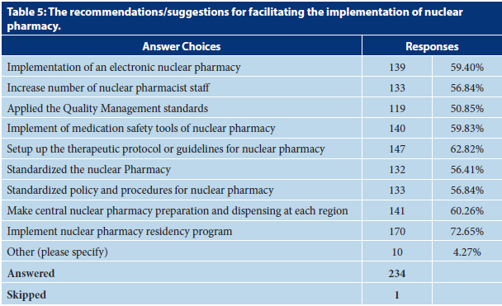

Slide 7
CONCLUSION:
In summary, the perception of nuclear pharmacy services and the knowledge of reasons for preventing nuclear pharmacy implementation by pharmacists is satisfactory. The most significant barrier to the implementation of nuclear pharmacy was the undergraduate and postgraduate education and training. The perception of pharmacists is affected by various factors, for example, females are more positive than males in their attitude. Age is an additional factor that affected the negative perception (young age), whereas the position held and number of years of experiences had the more positive perception. There was a significant positive correlation between location, age, and gender and perception of nuclear pharmacy services.

