Slide 1
Dentist’s Practice of Medication Safety in Saudi Arabia
Yousef Ahmed Alomi, Fouzia Abdul Karim Bukhary, Rahmah Abdulilah Alsinan

Slide 2
ABSTRACT:
Objective: The study aimed to exemplify the dentist’s practice of medication safety in the Kingdom of Saudi Arabia. Methods: It examines a cross-sectional survey that deliberated the dentist’s medication safety practice in Saudi Arabia. It self-reported an electronic survey of dentists, including dentists from internship to consultant, dental specialties in Saudi Arabia. The survey entailed respondents’ demographic information about dentists and the implemented medication safety in dental care, the medication’s safety items stated in dental care, and dental medications implemented the medication’s safety. The 5-point Likert response scale system was used with closedended questions. The data analysis of the dentist’s knowledge of medication safety is completed through the survey monkey system. The statistical package of social sciences (SPSS), Jeffery’s Amazing Statistics Program (JASP), and Microsoft excel sheet version 16 were employed in the study.

Slide 3
ABSTRACT:
Results: The total number of responding dentists was 242, with the mainstream of them coming from the central region 95 (39.26%) with statistically noteworthy among the areas (p<0.05). Of those, 144 (59.75%) were male, while 97 (40.25%) were female, with statistically significant between them (p<0.05). The average scores of the executed items for medication safety in dental care were 3.12 with high scores element was adverse drug reactions documentation system (3.26), and the vision of medication safety in dental care was 3.23. The average scores of frequently of the medications safety items reported in dental care was 3.17 with high scores element was pregnancy and lactation altering system (3.88) and patient’s education of dental medications (3.60). The highest scores of medication Safety (to authorities) the responsibility of types of healthcare professionals was a pharmacist (4.34) and dentist (4.23). The reliability test includes McDonald’s ω (0.980) and Cronbach alpha (0.979). Conclusion: The dentist’s practice of medication safety was inadequate in Saudi Arabia. Implementation of medication safety in dental care is obligatory to prevent dental mistakes and drug-related problems. Also, the study aimed to improve the patient safety culture among dental practices in Saudi Arabia.

Slide 4
Key Words :
Dentist,
Practice,
Medication,
Safety,
Care,
Saudi Arabia.

Slide 5
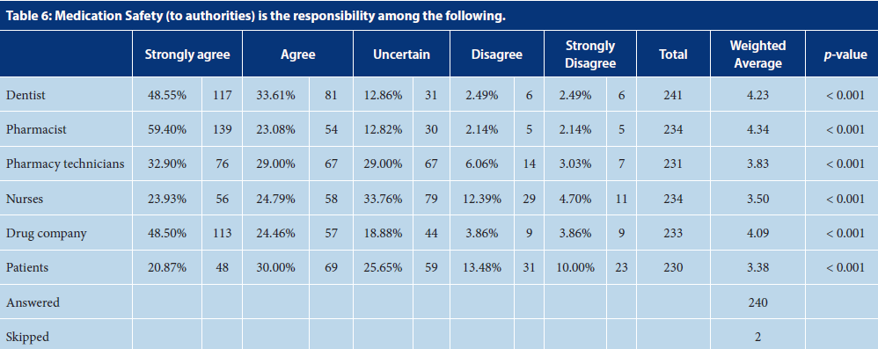

Slide 6
CONCLUSION:
The insight of dentists in the medication’s safety was insufficient, particularly in the medications safety items. The dentists poorly used medication safety equipment in dental practice. The dentists employed medication safety tools in high-risk medications (a drug for dental pain and anesthesia). The dentists esteem the pharmacist with the high accountability of medication safety in dental care followed by the drug company. The dental medications safety program desires to be recognized in dental care to prevent drug-related problems to progress patients outcomes.

