Slide 1
Clinical Outcome of Herbal Medicine-related Problems for Respiratory Viral Infections
Yousef Ahmed Alomi, Ghadeer Alhazmi,
Murouj Almaghrabi, Ghaida Alzahrani,
Mohammad Almatrafi

Slide 2
ABSTRACT:
Background: The use of herbal medicine to treat dissimilar respiratory conditions has been assumed for many decades. This survey analysis explores the clinical outcomes of herbal medicine-related problems for respiratory viral infections in Saudi Arabia. Design and Setting: A self-administered, structured questionnaire was sent to the public online, counting questions on the responders’ demographics and questions gaging different clinical outcomes of herbal medicine-related problems when treating respiratory viral infections in Saudi Arabia. Data analysis was performed through SPSS program version 26.

Slide 3
ABSTRACT:
Results: 486 participants responded to this questionnaire. 89.92% of the responders were from the west area in Saudi Arabia, 56.49% were in the age group between 18 and 30 years old. 18.32% were healthcare practitioners, while 53.85% of these practitioners were physicians. 18.74% of the responders applied herbal medications three times daily for respiratory viral infections. Only 4.31% of the responders established having side effects during the past year from herbal medications, while 3.58% visited a pharmacy for these side effects. Their healthcare professionals asked 20.04% about the use of herbal medications. Factors increasing the occurrence of adverse events were: that residents of the western region (p value=0.002), age group between 18 and 30 (p-value=0.046), females (p-value<0.001), low monthly income (p-value=0.013) and non-healthcare professionals (p-value=0.001). Conclusion: Although the occurrence of herbal medication-related problems is not common in Saudi Arabia, it can need medical assistance. Awareness of the public of the herbal medications adverse events is decisive.

Slide 4
Key Words :
Clinical,
Outcome,
Herbal Medicine,
Problems,
Viral Infections Saudi Arabia.

Slide 5
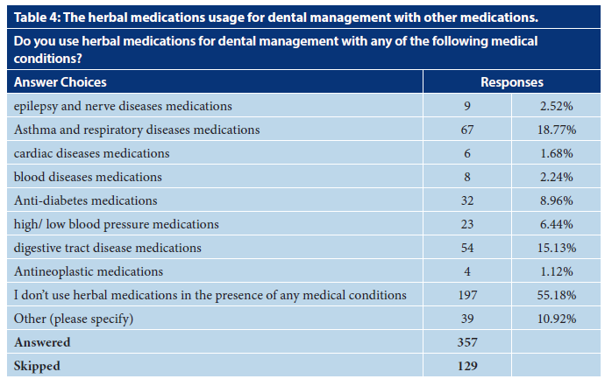

Slide 6
CONCLUSION:
Herbal drug-related problems are usually significant in Saudi Arabia, with frequently lead pharmacy visits or emergency and hospital admission. However, the public’s awareness and healthcare professionals towards the adverse effects of herbal medications should be upgraded. It can be accomplished through national campaigns by pharmaceutical companies and healthcare organizations. Additionally, further research is obligatory to discover the incidence of adverse events from herbal medications for other indications, which could be more serious than those offered in the contemporary study.

