Slide 1
Accounting and Financial in Pharmacy Practice: Education and Training
Yousef Ahmed Alomi, Ghadeer Zayed Aljumah, Nasser Rashid Alohlie, Naif Saleh Alamri, Maha Hussein Almadany, Riyadh M Alashban, Amani Abdullah Bahdailah, Abeer Hussin Almasoudi

Slide 2
ABSTRACT:
Objectives: To explore the accounting and financial system education and training in pharmacy practice as a new initiative in Saudi Arabia. Methods: It was a narrative review of accounting and financial policy and procedures in pharmacy practice. Litterateur searched various databases, including PubMed, Medline, and Google Scholar. The search period is from the 1960s until 15 October 2023. The term is in full-text English and includes Case Reports, Classical Articles, Clinical Conferences, Clinical Studies, Clinical Trials, Evaluation Studies, Government Publications, Guidelines, Meta-Analysis, Observational Studies, Practice Guidelines, Randomized Controlled Trials, Reviews, Systematic Reviews, with Humans subject. All hospital or community pharmacy services are included in a search term. Besides, the National and international guidelines of general infection control in hospital practice. The committee of pharmacy accounting policy and procedures formulated and consisted of various expert members. That includes clinical pharmacists, accountant specialists, and financial experts. The guidelines of the policy draft by one member by the second member were reviewed and corrected. The third revision was by the accountant specialist. The topic emphasizes the accounting system education and training in pharmacy practice of the Pharmacy policy.

Slide 3
ABSTRACT:
Results: The Pharmacy Infection control policy of the Research Education and Training consisted of various items. That has included program objectives, admission requirements, teaching and education methodology, and Pharmacy infection control Education and Training steps in pharmacy practice. The research education and training contained five models. For instance, accounting and financial cycle, pharmacy financial position statement analysis, and managerial accounting. Besides, the pharmacy feasibility studies, pharmacy accounting, and financial quality management. Each model describes the Module description, Learning Objectives, Module Outlines, and Competency items. Conclusion: The accounting and financial system education and training in pharmacy practice is a new initiative for pharmacy career professionals. It will improve pharmacy accounting and financial system skills and encourage pharmacist compliance with accounting and financial system regulations in different pharmacies in various healthcare organizations. Therefore, the accounting and financial system education and training policy and procedures are necessary for the pharmacy system in Saudi Arabia.

Slide 4
Key Words :
Accounting,
Financial,
Policy,
Pharmacy,
Education,
Training,
Saudi Arabia.

Slide 5
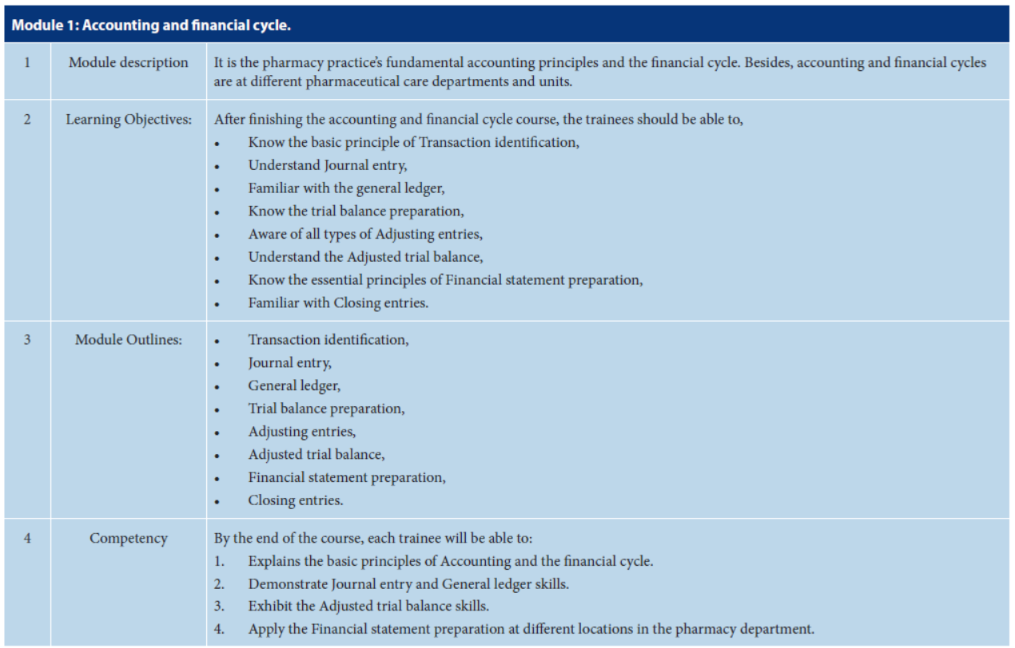

Slide 6
CONCLUSION:
Covering education and training in pharmacy accounting and financial systems is essential for undergraduate and postgraduate pharmacists. The training software consists of 5 weeks of coaching with five modules: Accounting and Financial Cycle, Analysis of Pharmacy Financial Situation, Operational Accounting, Pharmacy Feasibility Study and Pharmacy Accounting, and Financial Quality Control. It was done. Each module is explained by understanding the purpose, module outcomes, and competencies. Training and coaching in pharmacy accounting and financial system coverage and strategy can be carried out efficiently and conveniently at the pharmacy site. The level and methods of training and education in pharmacy accounting and financial systems have been surprisingly well received in Saudi pharmaceutical sales.

