Slide 1
Performances and Activities of Virtual Pediatrics Medication Counselling Clinic in Riyadh City, Saudi Arabia
Nouf Musleh Alassadi, Asma Mohammed Alzahrani, Haifa Shabeeb Almutairi, Tahani Mohammed Alotaibi, Mona Yousef Lubbad, Nouf Abdurazaq Alhaza, Raghad Maluoh Alanazi, Yousef Ahmed Alomi

Slide 2
ABSTRACT:
Objectives: To explore the activities and performances of a virtual pediatrics medication counseling clinic in Riyadh City, Saudi Arabia. Methods: it was a retrospective analysis of activities and performances of a virtual pediatric medicine counseling clinic operated by the pharmacist at a public pediatric and maternity hospital. The pharmacist documented all the activities, including demographic information of patients visiting the clinic, the reason for the counseling, medication requirements to be counseled, and patient counseling items based on international guidelines. The data analysis was done through SPSS version 20 and Microsoft Excel version 2021; descriptive analysis and logistic regression of factors associated with the reason for counseling.

Slide 3
ABSTRACT:
Results: The total number of patients who visited the virtual pediatric medicine clinic through 20 months was 1955, with (97.75) per month. The majority of patients were female in the year 2021, 204 (63.55%) vs. female 900 (61.19%) in 2021, compared to male 117 (36.46%) vs. males in year 2022 628 (38.81%) with non-significant differences (p=0.149). The majority of patients were diagnosed as Diabetic Miletus in both years, 145 (45.17%) vs 884 (54.47%), with statistical significance differences between two 2021 and 2022 (p=0.000). The majority of patients counseled due to high alert medication was 230 (71.65%) in 2021 vs. 1198 (73.32%) in 2022, with non-statistically significant difference between them (p=0.539), and chronic diseases such as diabetes and asthma 224 (69.78%) vs. 901 (55.14%) in the year 2021 and 2022 respectively with statistical significance differences between both years (p=0.000). Most medication counseled was Insulin Aspart in both years, 121 (21.72%) vs. 909 (31.92%), insulin Glargine 104 (18.67%) in 2021 vs. 555 (19.49%) in 2022, and Enoxaparin in both years 40 (7.18%) vs. 205 (7.20%). Conclusion: The virtual pediatric medicine counseling clinic served many patients, emphasizing pediatric chronic diseases such as Diabetes and Asthma. Future studies are highly recommended to measure the clinical and economic outcomes and patient satisfaction.

Slide 4
Key Words :
Virtual,
Pediatric,
Medication,
Counseling,
Clinic,
Saudi Arabia.

Slide 5
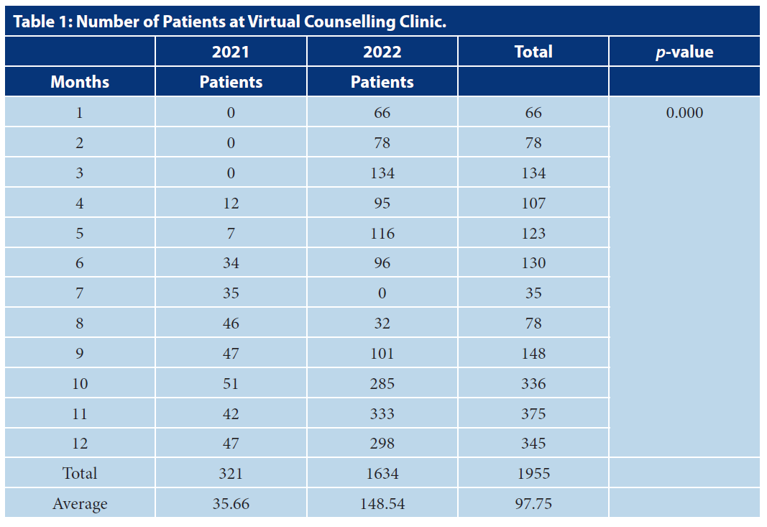

Slide 6
CONCLUSION:
The new technology serves the pharmacy practice to provide patients care with high efficiency and productivity. Telepharmacy is used for various purposes through the preparation and distribution of medicine. Besides, patients were counseled for their medication. The foundation of virtual pharmacy services is the new digital pharmacy era. Virtual clinical pharmacy services emphasize that virtual pediatric medicine counseling clinics offer new services to the pediatric and related caregivers.^{[15,21]} It can handle a high number of patients very quickly and more conveniently. The pharmacist provides comprehensive activities and performance to pediatric and adult patients, including counseling chronic disease medication such as diabetes, Asthma, and Epilepsy. The virtual pediatric counseling clinic must expand to cover more patients with considerable clinical and economic benefits, besides determining patient satisfaction with clinic services for improvement. The virtual pediatric medicine counseling clinic is crucial and highly recommended to be involved in patient care nationwide.

