Slide 1
National Survey of the Pharmacokinetics Services at Ministry of Health Hospitals in Saudi Arabia: Pharmacy Management Practice
Yousef Ahmed Alomi, Rasha Abdelsalam Elshenawy

Slide 2
ABSTRACT:
Objectives: To explore the pharmacokinetics services at Ministry of Health (MOH) hospitals in Saudi Arabia with an emphasis on pharmacy management practice.
Methods: This is a 2-month cross-sectional national survey related to the pharmacokinetics services with a focus on pharmacy management and resources at MOH hospitals in Saudi Arabia. The study consisted of two parts: the first part gathers demographic information and the second part contained 43 questions divided into four domains that were derived from the guidelines of the American Society of Health-System Pharmacists and from the literature. We used the 5-point Likert response scale system to obtain the responses of the participants, which consisted of closeended questions. An electronic questionnaire was distributed to the coordinators of all the clinical pharmacy services or drug information centers at MOH hospitals; it captures the data regarding education and training through a Survey Monkey system.

Slide 3
Results: There were 43 total responders from hospital pharmacies; the response rate was found to be 86%. The majority of pharmacokinetics services were provided to the adult patients (37 (86.05%)) followed by the pediatric and geriatric patients (19 (44.19%) and 13 (30.23%) respectively, with most of the hospitals covering less than 20 beds (23 (53.5%)). Most of the harmacokinetics services were provided through inpatient pharmacy (27 (62.79%), outpatient pharmacy and through discharge (9 (20.93%)). Most of the administration and management sections of the pharmacokinetics services were with the mission of pharmacokinetics services (68.8%) followed by the total quality anagement (67.6%) and policy and procedures (64.8%), whereas the least of the administration of pharmacokinetics services was found in the annual pharmacokinetics plan (60%), the pharmacokinetics strategic plan and pharmacokinetics technician competency (62.6%).

Slide 4
Conclusion: Although there is a daily demand for the pharmacokinetics services, only one-third of the hospitals had pharmacokinetics services to offer. Implementing the MOH pharmacokinetics services strategy is required at all MOH hospitals in Saudi Arabia.

Slide 5
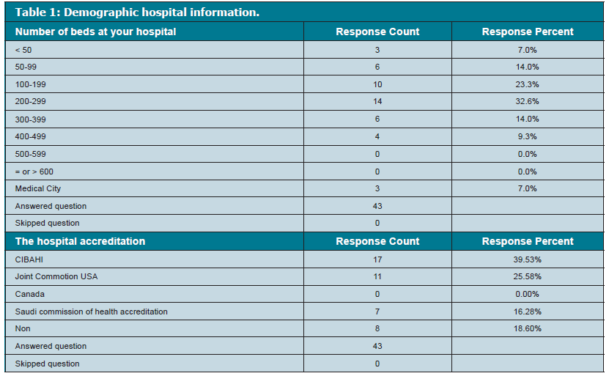

Slide 7
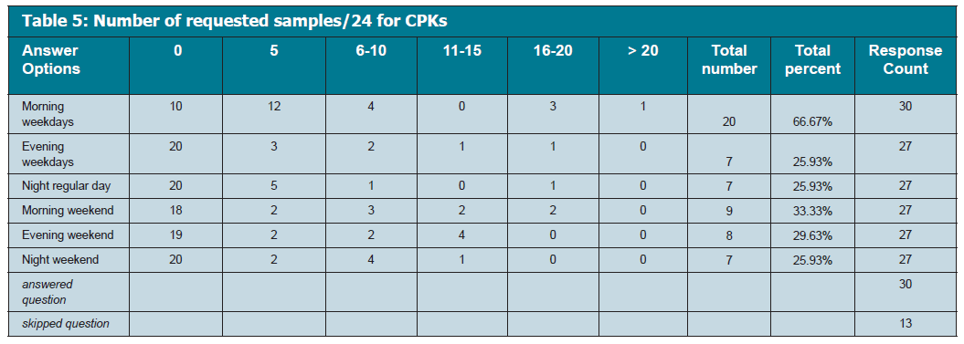

Slide 8
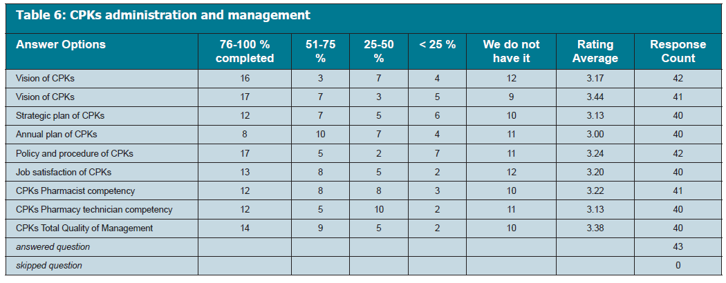

Slide 9
CONCLUSION
The CPKs have not been completed yet at MOH hospitals in KSA. There is the need to increase the number of clinical pharmacists who are specialized in this field with a focus on administration revision of the program and pharmacokinetics education and training at MOH hospitals in KSA.

