Slide 1
National Survey of the Pharmacokinetics Services at the Ministry of Health Hospitals in Saudi Arabia: Prescribing and Dispensing Medication
Yousef Ahmed Alomi, Rasha Abdelsalam Elshenawy

Slide 2
ABSTRACT:
Objectives: To explore the pharmacokinetics services at the Ministry of Health (MOH) hospitals in Saudi Arabia with an emphasis on prescribing and dispensing medication.
Methods: This is a 2-month crosssectional national survey of pharmacokinetics services. The study consisted of two parts: the first part captures demographic information and the second part is a questionnaire with 43 questions divided into three domains. The questions are derived from the guidelines of the American Society of Health-System Pharmacists (ASHP) and from the literature. We used the 5-point Likert response scale system to obtain responses of the participants; there were close-ended questions. The electronic questionnaire was distributed to all the coordinators of the clinical pharmacy services or to the drug information centers at MOH hospitals, The data were collected through the Survey Monkey system.

Slide 3
Results: A total of 43 hospital pharmacies responded to the survey; the response rate was found to be 86%. The pharmacists and nurses had privileges of prescribing medication as per pharmacokinetics services in nearly 18 (46.15%) and 16 (41.03%) hospitals respectively. At 14 (37.84%) hospitals, pharmacists have the privilege to request an estimation of patient’s drug levels and at 12 (30.77%) hospitals, they have the privilege to change drug sampling time. At 15 (38.46%) hospitals, nurses have the privilege to request an estimation of patient’s drug level and at 12 (31.58%) hospitals, they have the privilege to change drug sampling time. The commonly prescribed medications via pharmacokinetics consultation were gentamicin (23 (71.88%)), phenytoin (23 (71.88%)), carbamazepine (22 (70.97%)), sodium valproate (22 (70.97%)) and warfarin (22 (70.97%)). The pharmacokinetics altering system during an electronic prescription was found in 9 (26.5%) hospital pharmacies and the pharmacist was found to participate in pharmacokinetics research in 8 (23.5%) hospitals.
Conclusion: Healthcare providers including the pharmacists and nurses have a significant role in providing pharmacokinetics services to the patients. Expanding these services with standard guidelines and the electronic prescription is required in order to prevent drug- Pharmacokinetics related problems, improve the clinical outcome of the patient and reduce the economic burden.

Slide 4
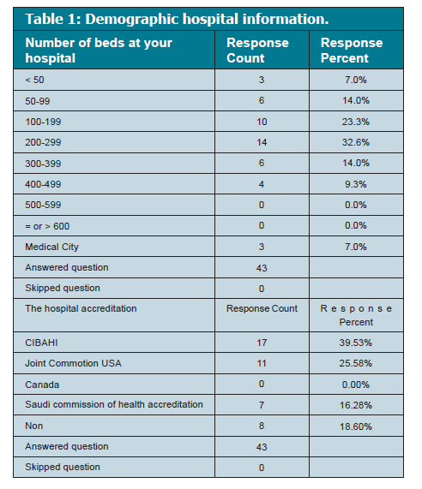

Slide 5
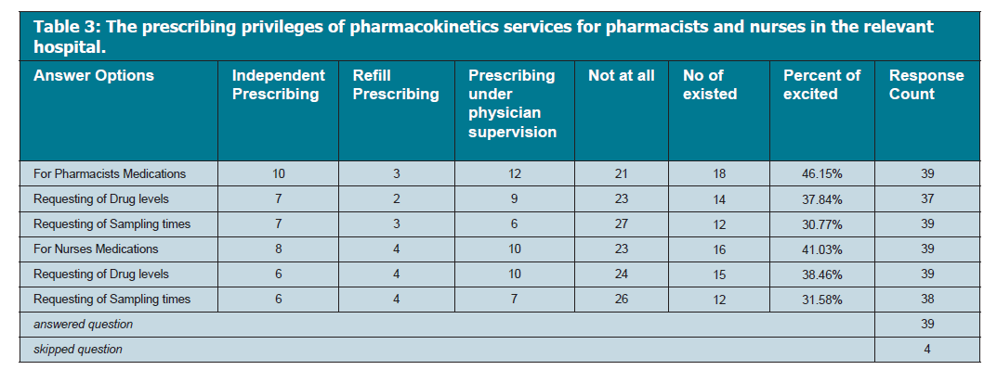

Slide 6
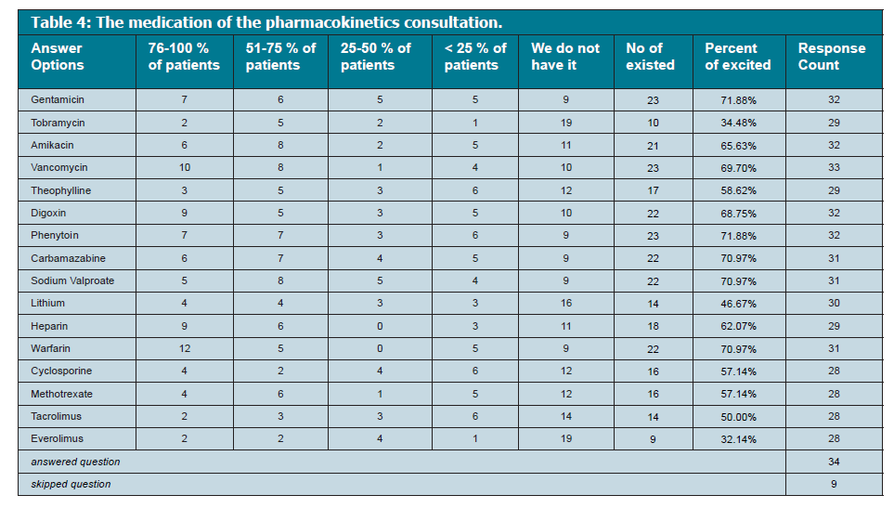

Slide 8
CONCLUSION
Healthcare providers including pharmacists and nurses had a significant role in providing pharmacokinetics services. Expanding these services with standard guidelines and electronic method of prescribing medication is needed to prevent drug-related problems, improve clinical outcome of the patient and reduce economic burden.

