Slide 1
Cost of Total Parenteral Nutrition Services at the Ministry of Health, Saudi Arabia
Yousef Ahmed Alomi, Aisha Omar Fallatah, Amjad Ahmad AL qahtani, Nesreen Al-Shubbar, Maha F Al-Yahya,
Estiqlal Hussain Al-Smail

Slide 2
ABSTRACT:
Objectives: The estimation of cost of total parenteral nutrition (TPN) is a part of the pharmacoeconomic program at the Ministry of Health (MOH), Saudi Arabia. In this study, we explored the cost analysis of TPN services by using American Model with local cost.
Methods: Simulation was performed for all 6 months of TPN services for neonate, pediatric and adult patients. King Salman Hospital in Riyadh, Saudi Arabia was chosen as the study site; it has 300 beds. The physician or the pharmacist prescribed TPN to their patients. The pharmacist reviews and prepares TPN. The nurse administers TPN and follows up with the doctor or the pharmacist. TPN was prepared through sterile 797 standards and automated compounding facilities. The costing was derived from MOH information database. The cost was calculated based on the variable expenses including personal cost, material cost and supply cost. Fixed costs included direct cost, non-salary cost and overhead cost. All costs were estimated in US dollar currency and local prices.

Slide 3
Results: A total number of 112 patients were prescribed with (1631) TPN orders; the total volume of TPN was 619,161.90 mL. Of these, 103 (91.96%), 6 (5.36%) and 3 (2.68%) were prescribed for neonatal, adult and pediatric patients, respectively. Of those with TPN orders, 1484 (90.99%), 108 (6.62%) and 39 (2.39%) were prescribed for neonatal, adult and pediatric patients, respectively. The total average number of orders per day was 4.47. Of those, 4.07, 0.3 and 0.11 was for neonatal, adult and pediatric patients, respectively. The average duration of TPN for adults, neonatal and pediatric patients was 18, 14.4 and 13 days, respectively. The total average direct cost for active ingredient in the TPN was 61.81 USD. Of those, 38.54 USD (62.35%), 16.63 USD (26.91%) and 6.64 USD (10.74%) was for pediatric, adult and neonatal patients. The estimated cost of TPN services for neonatal, adult and pediatric patients was 863.74 USD, 691.3 USD and 618.16 USD per day, respectively. The total annual and daily estimated expenditures of TPN orders were 629,865.02 USD and 212.22 USD; 44,795.24 USD and 207.39 USD; and 5,303.77 USD and 68.00 USD respectively for neonatal, adult and pediatric patients. The total annual and daily estimated cost were 314,764.70 USD and 3,055.97 USD; 22,398.12 USD and 3,733.02 USD; and 2,652.00 USD and 884.00 USD respectively for neonatal, adult and pediatric patients.

Slide 4
Conclusion: In this study, we performed cost-estimation of the TPN in Saudi Arabia. This is the first study at MOH in Saudi Arabia. It is an essential basic element of pharmacoeconomic program and cost analysis of TPN-related healthcare services.

Slide 5
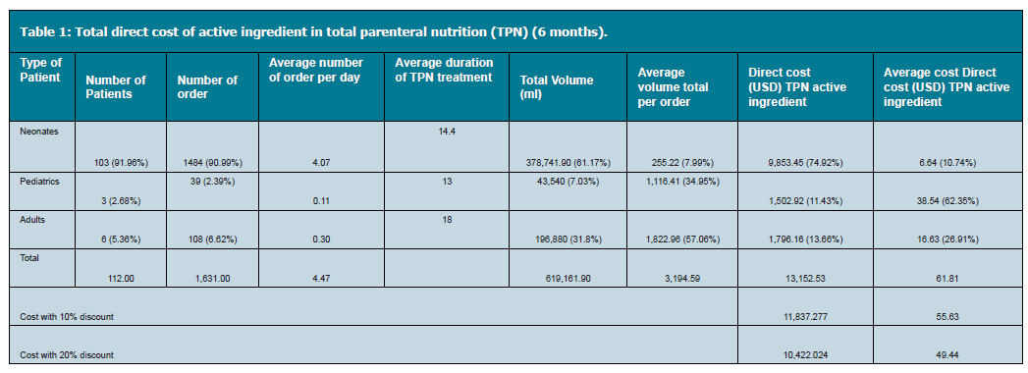

Slide 6
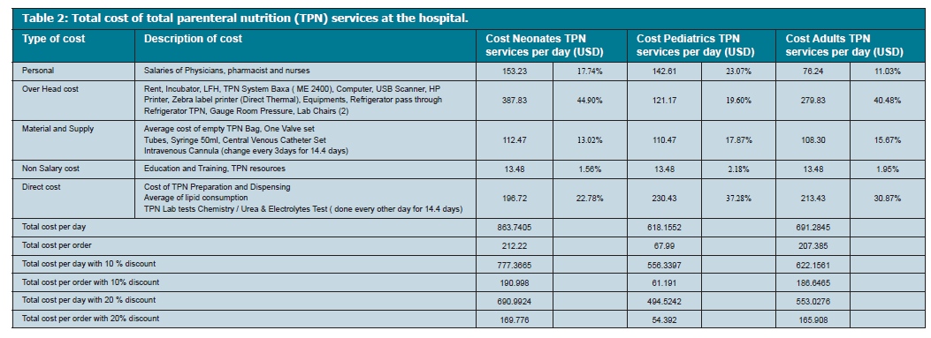

Slide 7
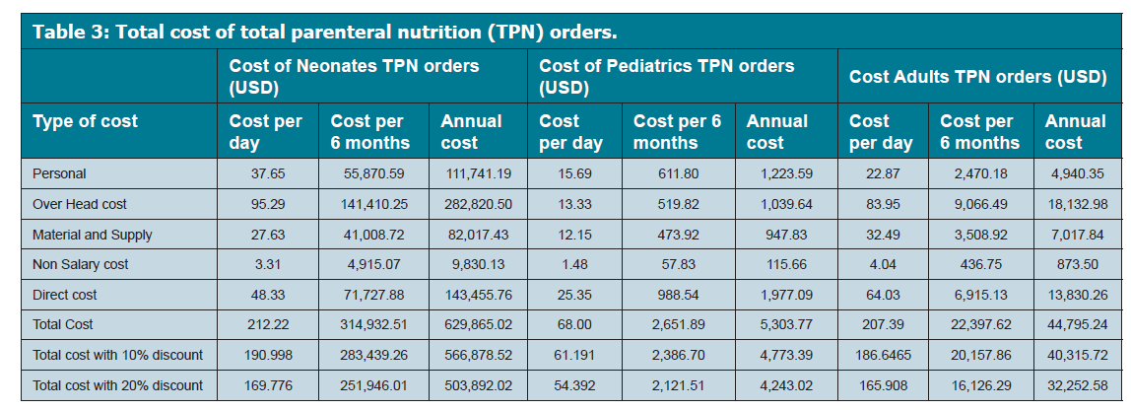

Slide 8
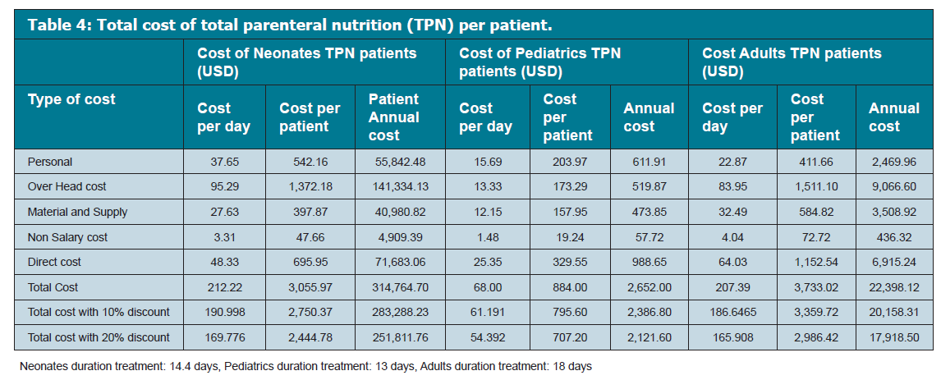

Slide 9
CONCLUSION
This is the first study to calculate the cost of TPN services and preparations in Saudi Arabia, the Gulf and Middle Eastern countries. The results assess all the healthcare professionals to measure cost efficiency of the nutrition support program based on the local cost. The TPN preparation cost should be updated regularly.

