Slide 1
Cost Analysis of Activities for Network Drug Information Centers at the Ministry of Health Hospitals in Saudi Arabia
Yousef Ahmed Alomi, Ban Abdullah Aldosary

Slide 2
ABSTRACT:
Objectives: In this study, we aimed to analyze the cost of network drug information services at the Ministry of Health (MOH) hospitals in Saudi Arabia.
Method: In this study, we simulated the 2-month cross-sectional survey data of all drug information centers at the MOH hospitals. Any drug store that has provided services to the healthcare professionals and the public participated in the questionnaire. National, regional and local drug information centers in the healthcare institutions participated in this survey. All type of hospitals or primary care centers (e.g. public, pediatric, maternity and psychiatry) were included in this study. The survey consisted of two parts: the first part collects demographics data and the second part analyzes the cost of activities of drug information centers. The clinical activities were derived from the model of the American College of Clinical Pharmacy (ACCP). The type cost consisted of related central drug information activities, the cost of the patient-centered drug information activity and the cost of Administrative drug information activities. All cost used US dollar currency.

Slide 3
Results: The survey was distributed to 60 drug information centers and a total of 46 centers responded to the survey; the response rate was 76.66%. Most of the hospitals (11 (23.9%)) had 100–199 beds and the others (11 (23.9%)) had 200–299 beds. The total daily cost of drug information activities was 6,002.18 USD. The highest cost of drug information activities was central drug information activities (2,654.69 USD (44.23%)) followed by the administration of drug information activities (2,280.59 USD (37.99%)) and patient-specific drug information activities (1,066.9 USD (17.77%)). The highest daily cost of drug information activities among central drug information center was responding to drug information inquiries ((536.24 USD)) followed by the residential training ((9274.46 USD)) and pharmacist’s training ((263.14 USD)).
Conclusion: The central activities of drug information centers costed the highest. Expanding the services to patient-specific activities will decrease morbidity, mortality and justify cost analysis at MOH hospitals in Saudi Arabia.

Slide 4
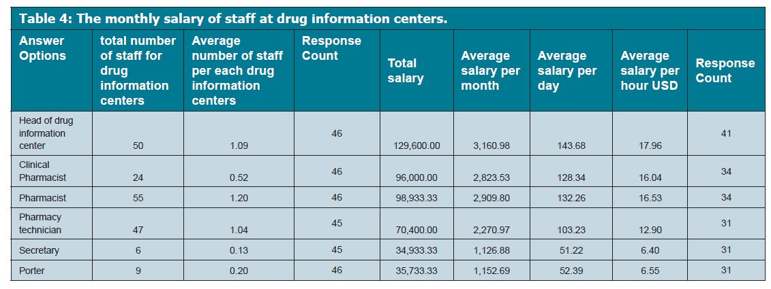

Slide 5
CONCLUSION
The cost analysis of drug information centers activities is essential to the calculated cost efficiency of drug information services. The common and administration drug information centers services activities are the highest cost. The providing services to other hospitals as outsourced fill with the new vision of Ministry of Health strategic plan in the Kingdom of Saudi Arabia.

