Slide 1
Pharmacist’s Practice of Reporting of Adverse Drug Reactions in Saudi Arabia
Fatima Fouad Al Dougahn

Slide 2
ABSTRACT:
Objectives: To assess and compare the practice of reporting Adverse Drug Reactions (ADRs) and related factors between community and hospital pharmacists in Saudi Arabia. Methods: This is a cross-sectional study. We used a structured, validated questionnaire to collect the data. A total of 263 pharmacists participated in the survey. The questionnaire captures demographic data of the participants and had 26 questions related to the practice of reporting ADRs and factors that encourage and discourage pharmacists from reporting ADRs.

Slide 3
ABSTRACT:
Results: Community pharmacists did not know the location of the ADR form, but hospital pharmacists did know about it, which was significantly different (P<0.05). Despite the increased awareness of ADR form among the hospital pharmacists’, the overall reporting rate was found to be meager among both the group of pharmacists. We found that several reasons led to the low reporting rate of ADR, for example, community pharmacists were unaware of how to report ADR and they considered that the ADR is too trivial to be reported compared to hospital pharmacists (P<0.05). in addition, community pharmacists were not know whom to report the ADRs compared to the hospital pharmacists, which was significantly different (P<0.05).

Slide 4
ABSTRACT:
Conclusion: The results of this study demonstrated that pharmacists who work at hospitals had a higher awareness of practicing system of reporting ADRs than that of community pharmacists. Increasing awareness among community pharmacists regarding the pharmacovigilance and ADR reporting systems is highly recommended in the Kingdom of Saudi Arabia.

Slide 5
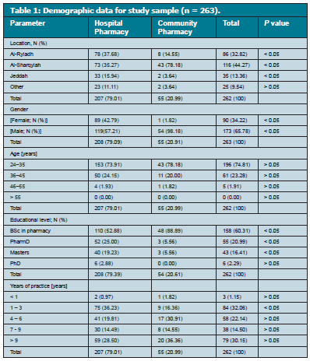

Slide 6
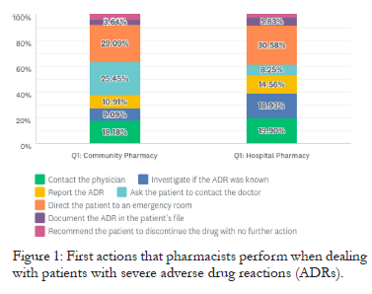

Slide 7
CONCLUSION:
Hospital pharmacists have higher awareness regarding the practice of reporting ADRs and pharmacovigilance system compared to community pharmacists. Despite this, the reporting rate of ADRs for both community and hospital pharmacists was meager. The mobile application has eased out the reporting process.

