Slide 1
Attitudes and Perceptions of Healthcare Professionals towards Pharmaceutical Care Services in Kingdom of Saudi Arabia
Yousef Ahmed Alomi, Ban Abdullah Aldosary, Sarah Abdullah Al-Hathlool, Maryam Ibrahim Almulhim, Amal Ali Alashaq, Yousef Aboshalaf, Mytham Al-Ethan

Slide 2
ABSTRACT:
Objective: Pharmaceutical care is a health science discipline in which pharmacists deliver patient care that improves medication therapy and helps health, wellness and disease prevention. An important issue in this area emphases on patient oriented rather than drug product-oriented service. The aim of this study to evaluate the attitudes and perceptions of health care professionals towards Pharmaceutical care services in Kingdom of Saudi Arabia. Methods: A 4-months cross-sectional survey of healthcare professionals was conducted in Kingdom of Saudi Arabia. The survey consisted of two-part demographic information and second part forty-nine questions divided into four domains. It included domain one: It included domain one: Primary or essential information about healthcare providers pharmacists, domain two: healthcare professionals information about the ambulatory care pharmacy, domain three: healthcare professionals information about pharmacist’s relationship and counseling and domain four: Healthcare providers perception of Pharmaceutical care services. All type of healthcare professionals included in the study. A 5-point Likert-type scale was used. There were open and closed-ended questions. The survey was distributed through social media by using what’s App to more than one thousand healthcare professionals overall Kingdom of Saudi Arabia. The survey was made in an electronic format and it analyzed domain two: healthcare professional’s information about Pharmaceutical care services through survey monkey system.

Slide 3
ABSTRACT:
Results: The total responders were 170 healthcare providers. Of those 150 (93.8%) were Saudi and 10 (6.25%) were non-Saudi. The gender distribution 129 (75.9%) were females and 41 (24.1%) were males. The most of the healthcare professionals were pharmacists 81 (47.65%), followed by nurses 27 (15.88%) and physicians 23 (13.53%). The majority of patient had visited a pharmacy more than 10 times in the past 12-months was 53 (31.36%), while 40 (23.67%) of respondents visited a pharmacy more than 5 to 9 times. The most common performances of pharmaceutical care services were dispensing of prescribed medication 119 (73.91%), medication consultation 89 (55.28%), dispensing of over the counter medications 88 (54.66%) and dispensing of non-medications supplements 74 (45.96%). The highest scores of pharmaceutical care services provides to the patients were at private’s hospitals (3.45) and non-MOH governmental hospitals (3.40). The most current experience of perception and challenges with high propriety scores were few pharmacist and clinical pharmacists, un-available of patient medication counseling privacy and Unclear handwriting prescription. The most Future Perception suggestion with high Propriety and Opportunity scores were Increase awareness of pharmacist role in public health and Implement patient counseling clinic operated by the pharmacy.

Slide 4
ABSTRACT:
Conclusion: Healthcare professional’s insight is the dynamic tool to develop pharmacy services. Increase the number of the clinical pharmacist, expand the awareness of pharmacist to the public and implement patient counseling clinic, will change the future vision of pharmacy career in Saudi Arabia.

Slide 5
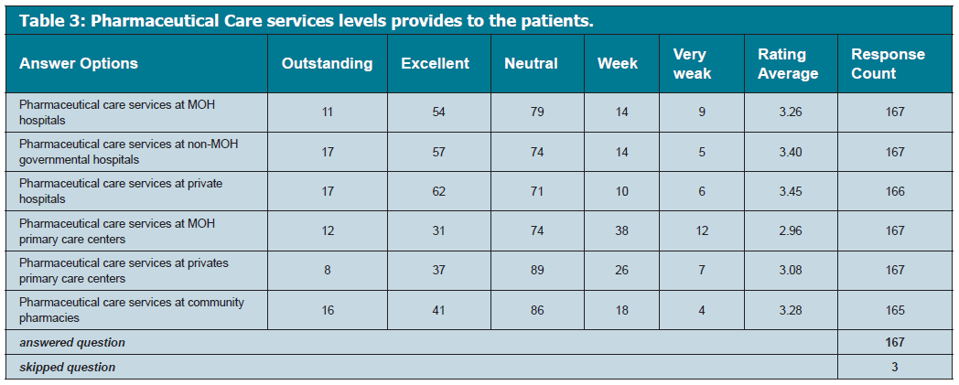

Slide 6
CONCLUSION:
The image and proficient performance of pharmacist at private sector are improving in Saudi Arabia. However, extra efforts should be rewarded to expand the clinical skills of the community pharmacists. The new concept of pharmaceutical care is extremely recommended to implement and expanded the pharmacy services at Kingdom of Saudi Arabia. They should play a hands-on role in becoming an effective and indispensable part of health care.

