Slide 1
Pharmacy Technician Workforce in Saudi Arabia over Twelve Years (2006-2017)
Yousef Ahmed Alomi, Saeed Jamaan Alghamdi,
Radi Abdullah Alattyh

Slide 2
ABSTRACT:
Objectives: To explore the workforce of pharmacy technician at Ministry of Health (MOH) institutions over the past twelve years (2006-2017) in the Kingdom of Saudi Arabia. Methods: It is a retrospective analysis of twelve years (2006-2017) of Ministry of Health pharmacy technician workforce at hospital practice. All data derived from the Ministry of Health Statistical Year Books and any missing appropriate information about pharmacy technician workforce, that’s will be estimated through allied healthcare professional’s data in each region including gender or nationality. It included pharmacy technician and exclude all types of pharmacists or clinical pharmacist’s workforces at MOH hospital and Primary Health Care Centers (PHCs) settings. All calculations were based on MOH workforce standards of hospitals and PHCs. All calculation was done using Microsoft Excel version ten.

Slide 3
ABSTRACT:
Results: The total number of pharmacy technician in all sectors, hospitals, primary healthcare centers and medical affairs administration increased from 4,289 to 8,373 over twelve years to 1.96-fold increments (2006-2017). The number of Saudi pharmacy technician increased from 3,064 to 8,061 to 2.63-fold increments while non-Saudi pharmacy technician decreased from 1,225 to 312 to 3.92-fold reductions. The rate of pharmacy technician to pharmacist decreased from 6.7 to 2.2 to 3.05-fold ratio reductions while the pharmacy technician per 10,000 population increased from 2.67 to 4.29 to 1.61-fold incremental ratio over the past twelve years. Conclusion: The pharmacy technician worked at the Ministry of Health institutions increased over the past twelve years. The Saudi pharmacy technician was increased with reduction of non-Saudi nationality. The male gender more than female. The ratio of pharmacy technician to pharmacist was reduced by time. The pharmacy technician workforces needed to explore at all healthcare institutions in the Kingdom of Saudi Arabia.

Slide 4
Key Words :
Pharmacy technician,
Hospital,
Health,
Centers,
Workforce,
Ministry of Health,
Saudi Arabia.

Slide 5
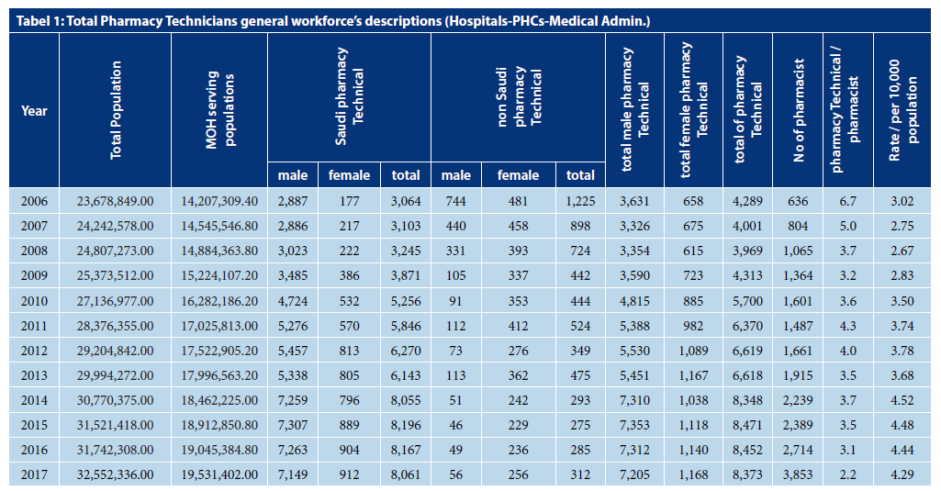

Slide 6
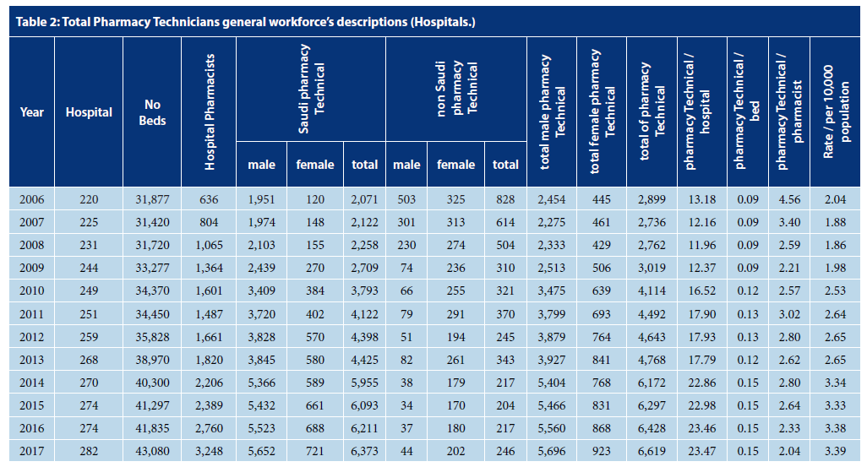

Slide 7
