Slide 1
Forecasting (2018-2030) and the Demand of Clinical Pharmacy Technician Workforce at Over Twelve Years (2006-2017) in Saudi Arabia
Yousef Ahmed Alomi, Saeed Jamaan Alghamdi,
Radi Abdullah Alattyh

Slide 2
ABSTRACT:
Background: The workforce of clinical pharmacy technician is one the elements of pharmacy strategic plan in Saudi Arabia. Objectives: The purpose of this study is to explore the demand clinical pharmacy technician’s workforce at Ministry of Health (MOH) hospitals and primary health care centers over the past twelve years (2006-2017) and forecasting during the years (2018-2030) in the kingdom of Saudi Arabia. Methods: It is a retrospective analysis of twelve years (2006-2017) of MOH hospitals, Primary Health Care Center (PHCs) of the pharmacy technician’s workforce and forecasting for future years (2018-2030). All data were derived from the Ministry of Health statistical year books and any missing appropriate information about pharmacy technician’s workforce that will be estimated through allied healthcare professional’s data in each region including gender. It included all types of pharmacy technicians included in the study while excluded all pharmacists or clinical pharmacist’s workforce at MOH intuitions. All calculations were based on MOH workforce standards of hospitals or PHCs updated literatures. All calculation was done using Microsoft Excel version ten.

Slide 3
ABSTRACT:
Results: The total average of hospitals was 253.92 in the kingdom of Saudi Arabia. The total average demand of clinical pharmacy technician at MOH hospitals will be (4,579.08) over twelve years (2006-2017) with a range (2,899 to 6,619). The total average demand of clinical pharmacy technician at primary healthcare centers will be (1,303) over twelve years (2006-2017) with a range (891 to 1,623). The total average demand of clinical pharmacy technician at hospital forecasting will be (10,271.34) over thirteen years (2008-2030) with a range (8,797.44 to 11,887.11). The total average demand of clinical pharmacy technician at primary healthcare centers forecasting will be (14,270.87) over thirteen years (2018-2030) with a range (12,223.05 to 16,515.79). Conclusion: The Ministry of Health hospitals and primary care centers sectors will be with the highest demand for clinical pharmacy technician in the future. The ratio of pharmacist to clinical pharmacy technician needs to be standardized at hospitals and primary healthcare services. Further, the analysis of the clinical pharmacy technician workforce is required in the kingdom of Saudi Arabia.

Slide 4
Key Words :
Demand,
Forecasting,
Clinical Pharmacy technician,
Workforces,
Ministry of Health,
Saudi Arabia.

Slide 5
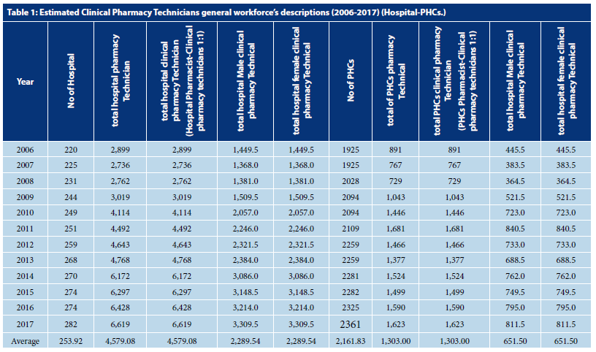

Slide 6
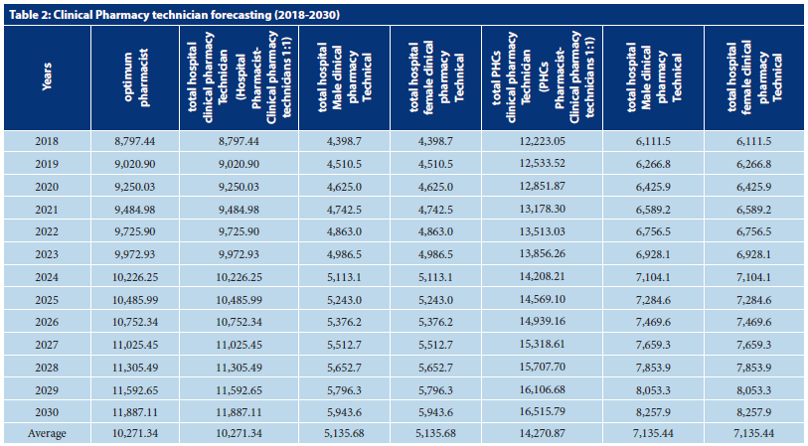

Slide 7
CONCLUSION:
The clinical pharmacy technician has an essential role with the clinical pharmacist in providing clinical care to the patients. The clinical pharmacy technician demand was determined with both equally genders. The ratio of pharmacist to clinical pharmacy technician was suggested to implement. The periodical analysis of clinical pharmacy technician is highly recommended at all governmental and private sectors in the kingdom of Saudi Arabia.

