Slide 1
National Survey of Pharmacokinetic Services in Saudi Arabia: Perceptions and Barriers of Service Implementations
Yousef Ahmed Alomi, Rasha Abdelsalam Elshenawy,
Rasha Abdelsalam Elshenawy

Slide 2
ABSTRACT:
Objectives: To explore the pharmacokinetic services at the Ministry of Health (MOH) hospitals in Saudi Arabia with an emphasis on perceptions and barriers of service implementation. Methods: This is a 2-month cross-sectional national survey of pharmacokinetic services with a focus on pharmacy management and resources at MOH hospitals in Saudi Arabia. The study consisted of two parts: the first part collected demographic information and the second part consisted of 43 questions divided into three domains. The questions were derived from the American Society of Health-System Pharmacists (ASHP) guidelines and from the literature. We used 5-point Likert response scale system with close-ended questions to obtain responses. An electronic questionnaire was distributed to the coordinators of the clinical pharmacy services or drug information centers at MOH hospitals and it analyzed the perceptions and barriers of pharmacokinetic service implementations section through the Survey Monkey system.

Slide 3
ABSTRACT:
Results: A total of 43 hospital pharmacies responded to the questionnaire, with the response rate of 86%. The majority of pharmacokinetic services were provided to the adult patients (37 (86.05%)) followed by the pediatric and geriatric patients (19 (44.19%) and 13 (30.23%), respectively) with most of the responding hospitals having less than 20 beds (23 (53.5%)). The categories with most of the barriers of pharmacokinetic service implementation were lack of knowledge (20 (64.52%)), lack of pharmacokinetic education (16 (51.61%)) and lack of an expert pharmacist in pharmacokinetic services (16 (51.61%)). Most of the responders agreed that clinical pharmacokinetic services were necessary for hospitals (23 (53.5%)). The responders agreed that the clinical pharmacist through pharmacokinetic services had a positive financial impact and cost avoidance on healthcare system (23 (53.5%)). Most of the responders stated that pharmacokinetic services improve the safety and efficacy of patient care (33 (89.2%)). Most of the responders agreed that the pharmacokinetic services improved patients’ clinical outcome (33 (89.2%)) and prevented drug-related problems (33 (89.2%)), whereas few of the pharmacokinetic services were provided only 10 (29.4%) over 24 hr per day. Conclusion: Despite the positive attitude of hospital management toward pharmacokinetic services, there was a lack of education and training regarding the same at MOH hospitals in Saudi Arabia. Revision of strategic planning of pharmacokinetic services with regard to their improvement and implementation are required at all MOH hospitals in Saudi Arabia.

Slide 4
Key Words :
Pharmacokinetics,
Management,
Pharmacy resources,
Ministry of Health,
Saudi Arabia.

Slide 5
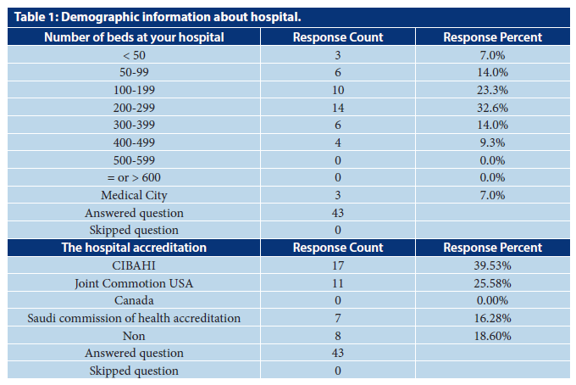

Slide 6
CONCLUSION:
The implementation of CPSs was found to be perceived as excellent by the pharmacists at MOH institution in KSA. There was incomplete of the pharmacokinetic services at most of the hospitals because of missing the pharmacokinetic education and expert clinical pharmacokinetics pharmacist. It is necessary to overcome the barriers and improve the services and then improve the clinical outcome of patients and avoid the additional economic burden on the healthcare system at the MOH hospitals in KSA.

