Slide 1
Cost Analysis of Clinical Compounding in Saudi Arabia: Anti-tuberculosis Pediatrics Formulations
Yousef Ahmed Alomi, Faiz A. Bahadig, Malika Alhadab, Mona Lubbad, Ebtesam Nazal,
Mayssa Ahmed Assiri

Slide 2
ABSTRACT:
Objective: In this study, we explored the cost analysis of selected pediatric antituberculosis formulations available at the pharmacy of a pediatrics and maternity hospital in Riyadh city, Saudi Arabia. Methods: This is a retrospective cost analysis study of pediatric anti-tuberculosis formulations conducted at a pediatrics and maternity hospital having 300 beds in Riyadh city, Saudi Arabia. The pharmacy section of this hospital receives the specific formulation from the physician. Then the expert pharmacist provides the clinical compounding services to healthcare staff and patients over 8 hr per day for 5 days per a week. The pediatric formulations consisted of selected anti-tuberculosis medications. The cost analysis included variable expenses such as personal cost, material cost and supply cost. Fixed costs included direct cost, nonsalary cost and overhead cost. All costs were derived from the Ministry of Health information database. All costs were analyzed in terms of US dollar currency by using the Microsoft Excel software version 10.

Slide 3
ABSTRACT:
Results: The estimated average total standard cost of pediatric anti-tuberculosis formulations per hour was 53.82 USD, which included 58.58% (31.53 USD) personal cost, 25.14% (13.53 USD) overhead cost, 3.34% (1.8 USD) material and supply cost and 12.93% (6.96 USD) non-salary cost. The average estimated cost of rifampicin per preparation was 11.36 USD. The total annual cost of rifampicin was 1363.20 USD. The average estimated cost of pyrazinamide per preparation was 6.835 USD. The total annual cost of pyrazinamide was 68.35 USD. The average estimated cost of isoniazid per preparation was 8.515 USD. The total annual cost of isoniazid was 85.15 USD. Conclusion: Two anti-tuberculosis pediatric formulations (rifampicin and isoniazid) were available for various prices, whereas pyrazinamide was not available as pediatric formulation either locally or in USA and UK. The pharmacist should prepare all anti-tuberculosis pediatric formulation when needed. The cost analysis of all anti-tuberculosis pediatric formulations should be determined in order to meet health insurance and the strategies of New Saudi Vision 2030 in the Kingdom of Saudi Arabia.

Slide 4
Key Words :
Cost,
Clinical compounding,
Anti-tuberculosis,
Pediatric formulations,
Ministry of Health,
Saudi Arabia.

Slide 5
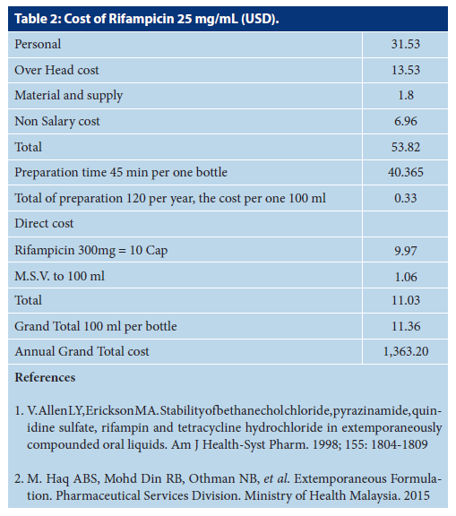

Slide 6
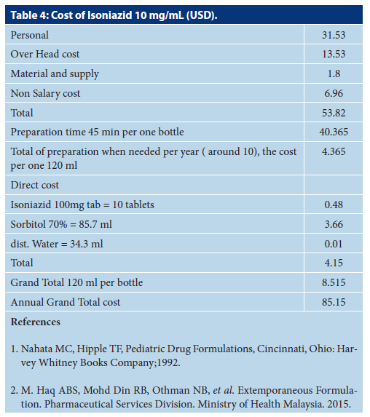

Slide 7
CONCLUSION:
Tuberculosis is one of the most common diseases of the developing countries, including Saudi Arabia. Most of the oral medications for adults or adolescents with different dosage forms are available in the local and international market. However, most of the anti-tuberculosis pediatric formulation is seldom found. The extemporaneous preparation of pediatric formulation of anti-tuberculosis medications, including cost analysis is an essential requirement of pharmacy strategic plan and New Saudi Vision 2030. The cost analysis of pediatric anti-tuberculosis medications is recommended to be conducted regularly in the KSA.

