Slide 1
Cost Analysis of Clinical Compounding in Saudi Arabia: Autoimmune and Gastrointestinal Pediatric Formulations
Yousef Ahmed Alomi, Malika Alhadab,
Mona Lubbad, Faiz A. Bahadig,
Ebtesam Nazal

Slide 2
ABSTRACT:
Objective: To explore the cost analysis of selected autoimmune and gastrointestinal pediatric formulations in Riyadh city, Saudi Arabia. Methods: This is a retrospective cost analysis study of autoimmune and gastrointestinal pediatric formulations at a pediatrics and maternity hospital in Riyadh city, Saudi Arabia. The extemporaneous pharmacy section regularly receive prescriptions with specific formulation from physician. The expert pharmacist applies the international standard of clinical compounding for all pediatric formulation related issue over 8 hr per days for 5 days per a week. The pediatric formulations consisted selected autoimmune and gastrointestinal medications. The cost analysis includes variable expenses such as personal cost, material cost and supply cost and fixed costs includes direct cost, non-salary cost and overhead cost. All costs were derived from the Ministry of Health information database. All costs were considered based on US dollar currency. In this study, we analyzed the cost of autoimmune and gastrointestinal pediatric formulations through the use of Microsoft Excel software version 10.

Slide 3
ABSTRACT:
Results: The estimated average total standard cost of pediatric formulations per hour was (53.82 USD). The average estimated cost of hydrocortisone per preparation was (12.896 USD). The total annual cost of hydrocortisone was (1547.52 USD). The average estimated cost of prednisolone per preparation was (4.6 USD). The average estimated cost of allopurinol per preparation was (6.99 USD) and the average estimated cost of sildenafil per preparation was (25.05 USD). The average estimated cost of omeprazole per each one preparation was (24.07 USD) and the total annual cost of omeprazole was (7221 USD). The average estimated cost of ranitidine per preparation was (5.248 USD) and the total annual cost of ranitidine was (2760.45 USD). The average estimated cost of baclofen per preparation was (21.266 USD) and the total annual cost of baclofen was (7655.76 USD). Conclusion: Based on the cost analysis, the cost of selected pediatric autoimmune and gastrointestinal pediatric formulations were higher than the ready-made products manufactured by pharmaceutical companies. The pharmacist should select the cheapest one among them. The cost analysis of pediatric formulation can be used to cover health insurance and meet the updated pharmacy strategic plan and New Saudi Vision 2030 in the Kingdom of Saudi Arabia.

Slide 4
Key Words :
Cost,
Clinical,
Compounding,
Autoimmune,
Gastrointestinal,
Pediatrics,
Formulations,
Ministry of Health,
Saudi Arabia.

Slide 5
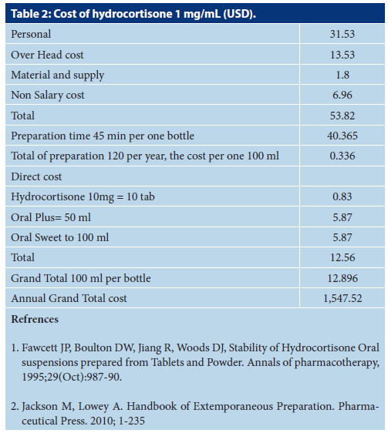

Slide 6
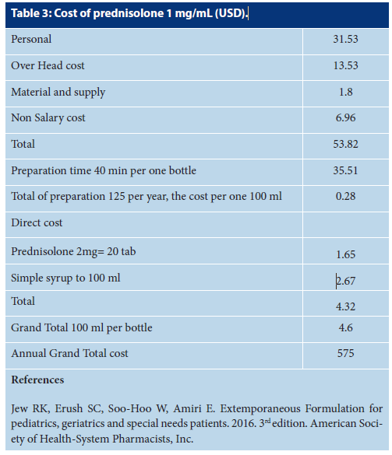

Slide 7
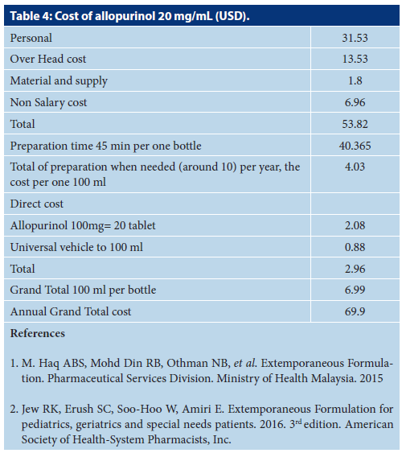

Slide 8
CONCLUSION:
Most of the immunosuppressive agents or gastrointestinal medications dosage forms are available in the local or international market for adult population. However, the pediatric formulations of these products are not commonly found in the market. The extemporaneous preparations with cost analysis are part of pharmacy strategic plan with New Saudi Vision 2030. Annually or once in every 2 years cost analysis of rarely used pediatric immunosuppressive agents or gastrointestinal medications is required in order to develop pharmacy budget and pharmacoeconomic implementation in the KSA.

