Slide 1
Cost Analysis of Clinical Compounding in Saudi Arabia: Antihypertensive of Pediatric Formulations
Yousef Ahmed Alomi, Fatimah Fouad Al Doughan,
Faiz A. Bahadig, Malika Alhadab, Mona Lubbad,
Ebtesam Nazal

Slide 2
ABSTRACT:
Objectives: The primary objective of this study was to explore cost analysis of pediatric formulations in Riyadh city, Saudi Arabia. Methods: This is a retrospective study of cost analysis of pediatric formulations at 300-bed pediatric and maternity hospital in Riyadh city, Saudi Arabia. The pharmacy section of this hospital receives the specific formulation from the physician. Then, the expert pharmacist applied the international standard for clinical compounding and provides services to the healthcare staff and patients over 8 hr per day for 5 days per week. The pediatric formulations consisted of but not limited to antibiotics, anti-tuberculosis (TB) medications and anti-hypertensive medications. The cost analysis included the variable expenses such as personal cost, material cost and supply cost and fixed expenses such as direct cost, non-salary cost and overhead cost. The cost was derived from the Ministry of Health information database. All costs used have been analyzed in US dollar currency. In this study, we analyzed the cost of antihypertensive medications for pediatric use through the Microsoft Excel software (version 10).

Slide 3
ABSTRACT:
Results: The estimated average total standard cost of pediatric formulations per hour was 53.82 USD and consisted of 58.58% (31.53 USD) for personal cost, 25.14% (13.53 USD) for overhead cost, 3.34% (1.8 USD) for material and supply cost and 12.93% (6.96 USD) for the non-salary cost. The average estimated cost of Propranolol, Captopril, Methyldopa, Amlodipine and Hydralazine per each preparation was 8.27 USD, 2.37 USD, 6.88 USD, 17.385 USD and 49.44 USD, respectively. Conclusion: To the best of our knowledge, this is the first study which demonstrated the cost analysis of antihypertensive pediatric formulation in the Kingdom of Saudi Arabia. The pediatric formulations with cost analysis can involve health insurance coverage. Targeting the cost analysis of all pediatric formulation is highly recommended to fit with Saudi vision 2030 in the Kingdom of Saudi Arabia.

Slide 4
Key word:
Cost,
Analysis,
Clinical,
Compounding,
Antihypertensive,
Pediatric,
Formulations,
Saudi Arabia.

Slide 5
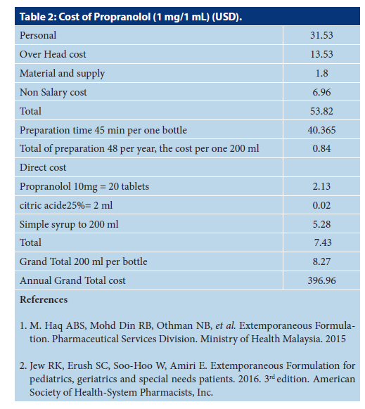

Slide 6
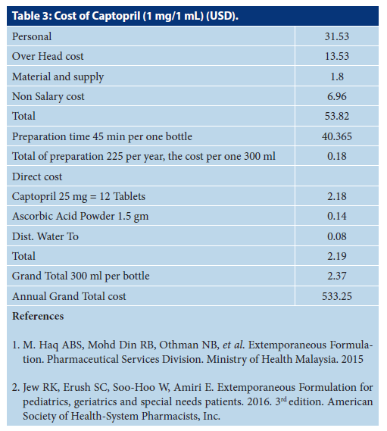

Slide 7
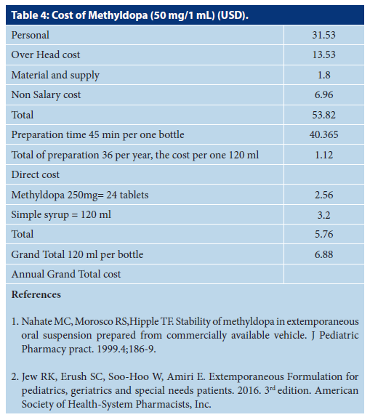

Slide 8
CONCLUSION:
Cost analysis of pediatric formulations is a critical and a vital element in the pharmacy strategic and health insurance system. In this study, we performed cost analysis of antihypertensive pediatric formulations. Several factors should be conducted to reduce the cost of pediatric formulations. The updating of cost analysis for pediatric formulations of the antihypertensive drug is highly recommended in order to prevent the economic burden on the healthcare system at the MOH hospitals in the KSA.

