Slide 1
Cost Analysis of Clinical Compounding in Saudi Arabia: Nephrology Pediatrics
Formulations
Yousef Ahmed Alomi, Malika Alhadab,
Faiz A. Bahadig, Mona Lubbad,
Ebtesam Nazal

Slide 2
ABSTRACT:
Objective: To explore cost analysis of selected renal pediatric formulations in Riyadh city, Saudi Arabia. Methods: It is a retrospective cost analysis of pediatric formulations at 300-beds pediatrics and maternity hospital in Riyadh city, Saudi Arabia. The pharmacy section received the specific formulation from physician then the expert pharmacist applied the international standard of clinical compounding through by providing to healthcare staff over eight hours per days for five days per a week. The pediatric formulations consisted selected renal products. The analysis of the cost included the variable expenses included personal cost, material and supply cost. Fixed costs, including, direct costs, non-salary cost and overhead cost. The cost was derived from the Ministry of Health information database. All cost was used US dollar currency. The study analyzed the cost of Nephrology pediatrics formulations through the Microsoft Excel sheet version 10th.

Slide 3
ABSTRACT:
Results: The estimated average total standard cost of pediatric formulations per hour was (53.82 USD). The average estimated cost of Hydrochlorothiazide per each preparation was (5.204 USD) and the total annual cost of Hydrochlorothiazide was (2,071.2 USD). The average estimated cost of Acetazolamide per each preparation was (5.72 USD) the total annual cost of Acetazolamide was (366.1 USD). The average estimated cost of Spironolactone per each preparation was (2.513 USD) and the total annual cost of Spironolactone was (1,507.8 USD). The average estimated cost of Sodium citrate per each preparation was (1.23 USD) with a total annual cost of Sodium citrate was (599.01 USD). The average estimated cost of Citric Acid per each preparation was (1.136 USD) with a total annual cost of Citric Acid was (81.782 USD). Conclusion: Cost analysis of pediatrics formulation with emphasis on medications used for renal diseases is primary tool of pharmacoeconomic and health insurance. The pharmacist play role in the preparation of renal medications and cost analysis related issue. This is new study in Kingdom of Saudi Arabia and Gulf or Middle East countries with and meet the new Saudi vision 2030 in the Kingdom of Saudi Arabia.

Slide 4
Key Words :
Cost,
Clinical,
Compounding,
Nephrology,
Pediatrics,
Formulations,
Ministry of Health,
Saudi Arabia.

Slide 5
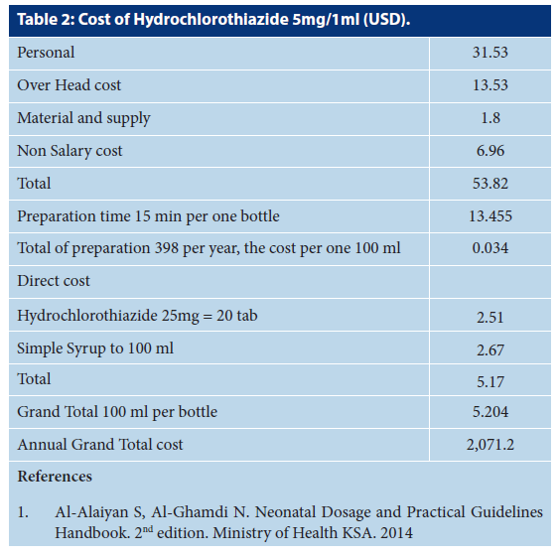

Slide 6
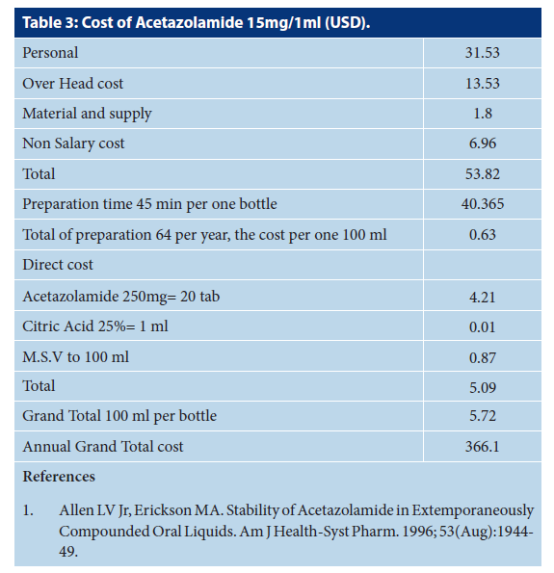

Slide 7
CONCLUSION:
Although several products ready-made though pharmaceutical companies, still the pediatric renal formulation not available in the local or international market with product prices. The cost analysis of extemporaneous preparation of renal product is the primary tools of Pharmacoeconomics goal of new pharmacy strategic with Saudi vision 2030. Regular measures of a cost analysis of the renal extemporaneous product are highly recommended of pediatric pharmacy services in the kingdom of Saudi Arabia.

