Slide 1
National Survey of Pharmacy and Therapeutic Committee in Saudi Arabia: Meetings, Organization, and Management
Yousef Ahmed Alomi, Sultan Mohammed Al-Jarallah,
Rasha Abdelsalam Elshenawy, Faiz A Bahadig Rph

Slide 2
ABSTRACT:
Objective: Pharmacy and Therapeutic Committee (PTC) is required for the effective running of a hospital. In the beginning, there was no such concept of drug committee, but with the advent of time, the need for an effective PTC started increasing. In the PTC, the pharmacist, physicians and nurses play an important role, in addition to the presence of an administrative. This study aims to explore the importance of having effective meetings organization and management of PTC at Ministry of Health (MOH) hospitals in Saudi Arabia. The purpose of this study was to explore the meetings organization and management of PTC at MOH hospitals in Saudi Arabia. Methods: This is a 4-month cross-sectional national survey of PTC at MOH hospitals in Saudi Arabia. The survey consisted of two parts: the first part collected demographic information and the second part consisted of 93 questions divided into four domains: Domain 1: the scope, structure and responsibilities; domain 2: the formulary management system; domain 3: evaluation of drug formulary and decision-making; and domain 4: organization and management of committee meetings. This questionnaire was prepared in an electronic format and was distributed all drug information centers at MOH hospitals. It analyzed organization and management of committee meetings through Survey Monkey system.

Slide 3
ABSTRACT:
Results: A total of 50 drug information centers responded to the questionnaire (100% response rate). The person leads the discussion in PTC was a Chairman of the Committee (29 (58%)), Chief of Pharmacy (13 (26%)) and Director of Drug Information (3 (6%)). The number of scheduled meetings per year (1–4) was 18 (36%) per hospital with a duration (1-2 hrs) at 48 (96%). Most of discussions were related to medications of infectious diseases (26 (52%)) and cardiovascular diseases (21 (42%)). Most of the challenging recommendations that needed implementation was a lack of resources (37 (74%)), lack of hospital administrator support (23 (46%)) and lack of pharmacist role (18 (36%)). Conclusion: The PTC is a demanding scientific resource and administrative support. Total quality management system, workload analysis, positive outcomes of PTC were lacking. Special education and training needs to be provided to all the healthcare providers with hospital administrator’s support.

Slide 4
Key Words :
National Pharmacy and Therapeutic Committee,
Ministry of Health,
Saudi Arabia,
Meetings,
Organization and Management.

Slide 5
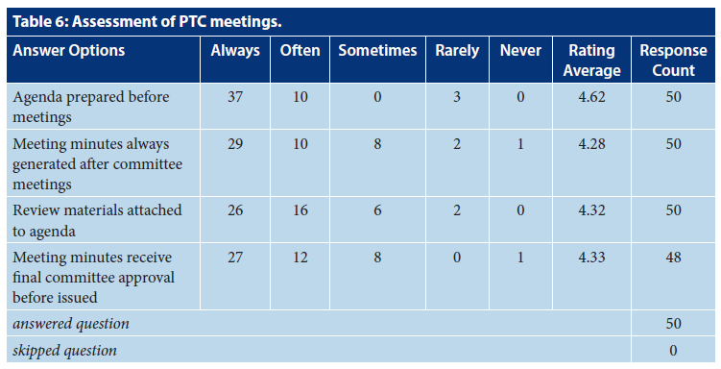

Slide 6
CONCLUSION:
The organization of meeting by PTC at MOH hospitals is not appropriate. PTC lacks resources and administration support. The clinical pharmacist role was missing in the PTC in functioning. Review of PTC requirements and plan is required to improve the activities and performances of PTC. A regular survey of PTC meeting and organization is highly recommended at MOH hospitals in the KSA.

