Slide 1
Patient’s General Perception and Attitude toward Pharmacists in Saudi Arabia
Yousef Ahmed Alomi, Abeer Hussin Almasoudi, Sarah Abdullah Al-Hathlool, Maryam Ibrahim Almulhim, Yousef Aboshalaf, Mytham Al-Ethan

Slide 2
ABSTRACT:
Purpose: To explore the patient’s perception and attitude toward pharmacists in Saudi Arabia. Methods: It is a 4-month cross-sectional survey of patient perception of pharmacists. The survey consisted of 49 questions divided in two parts: the first part collects demographic information and the second part contains questions on 4 domains: (1) patient general perception of pharmacist, (2) patients perception of pharmaceutical care services, (3) patient perception of visiting ambulatory care, (4) patient’s perception of pharmacist’s relationship and counseling. The 5-point Likert response scale system was used. The questions were open and closed-ended. The survey was distributed through social media at a 500-bed general hospital in Alhassa region, an ambulatory care pharmacy. The authors interviewed the patients with an electronic survey documentation. The survey was in an electronic format and it analyze domain one primary or necessary information about patient medication through the survey monkey system.

Slide 3
ABSTRACT:
Results: A total of 617 patients responded to the survey. Of them, 536 (87.7%) were Saudi and 75 (12.3%) were non-Saudi nationals. There were 457 (74.1%) female and 160 (25.9%) male responders. In the past 12 months, most of the patients [222 (36%)] visited the pharmacy more than 10 times, whereas the others [122 (19.8%)] visited the pharmacy at least 5–9 times. Most of the patients 481 (83.5%) spent less than 11 min with the pharmacist. The highest score was obtained for the statements related to pharmacy job vital in our society (4.63), the pharmacist had a very significant role in preventing medication errors (4.4), the necessity of present pharmacist schools (4.09) and the pharmacist is the first person ask him about drugs (4.01). More 60% of responders will choose the pharmacy as professional specialty or suggest the family members or friend select the pharmacy professional. The pharmacist shared in public education through the television and media (3.7) and newspaper (3.65) followed by schools (3.56) and public education exhibitors (3.48). Most of the patients visited the pharmacist to seek help in health diseases 429 (73.1%), the pharmacist knows more about drug doses and adverse drug reaction 224 (38.16%, followed by free consultation and 166 (28.28%) and no need for an appointment for pharmacy visit. Also, the patient refused to utilize the pharmacy just for cosmetics 404 (67%). Conclusion: According to our results, patient’s perception during pharmacy visit was found to be acceptable. Majority of patients had a good perception of a pharmacist and his role with patients and the general public. The pharmacist should expand pharmaceutical care services overall healthcare institutions in Saudi Arabia.

Slide 4
Key Words :
Patient,
Perception,
Attitude Pharmacists,
Saudi Arabia.

Slide 5
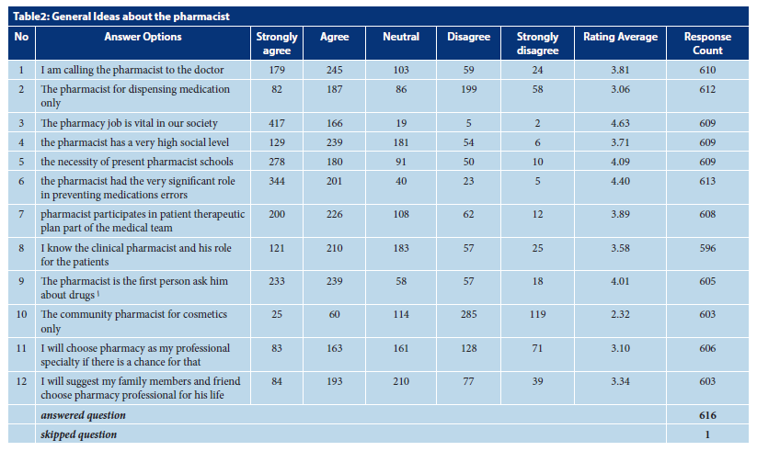

Slide 7
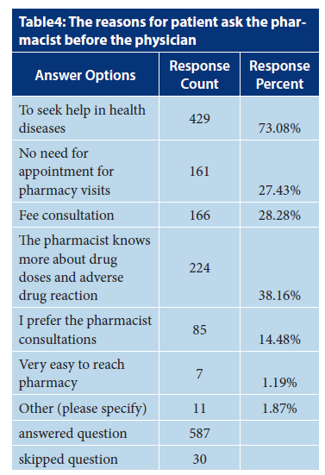

Slide 8
CONCLUSION:
The patient’s perception of a pharmacist during pharmacy visit was found to be neutral despite some factors being missed related to drug therapy monitoring. Targeting to expand the medication non-adherence and resolution are highly suggested to improve patient’s perception of pharmacist during pharmacy visit in the Kingdom of Saudi Arabia.

